Slide 1
Effect of Alcohol-mediated Renal Denervation on Blood Pressure in the Presence of Antihypertensive Drugs:
3-month Primary Results From the Target BP I
Randomized Trial
David E. Kandzari, MD, FACC, MSCAI, on behalf of the TARGET BP I Investigators
Piedmont Heart Institute Atlanta, Georgia david.kandzari@piedmont.org @Kandzari

Slide 2
Disclosure
Within the past 12 months, I or my spouse/partner have had a financial interest/arrangement or affiliation with the organization(s) listed below
Affiliation/Financial Relationship Company
Grant/Research Support (Institutional)
Ablative Solutions, Biotronik, Medtronic Orbus Neich, Teleflex
Consulting Fees/Honoraria
Medtronic, HyperQure, Ablative Solutions
Major Stock Shareholder/Equity
BioStar Ventures (none related to ASI)
Royalty Income
None
Ownership/Founder
None
Intellectual Property Rights
None
Other Financial Benefit
None

Slide 3
TARGET BP I
Background
Globally, over 1/3 of adults have hypertension, yet many remain uncontrolled, leading to increased risk of cardiovascular events
A 5-mmHg absolute reduction in office systolic blood pressure leads to a 10% reduction in major CV events¹
New blood pressure guidelines motivated by increasing awareness of benefit with more intensive blood pressure control, unacceptable levels of hypertension control^{2,3}, and increasing recognition of non- adherence to antihypertensive medications identify the need for alternative treatment options
Renal denervation (RDN) procedure targets the sympathetic nervous system to lower blood pressure
Catheter-based perivascular delivery of dehydrated alcohol represents a novel method of neural ablation, achieving a confluent arc of ablation with single, targeted treatment within the renal artery
To further explore outcomes with alcohol-mediated RDN in the presence of antihypertensive medications, an international sham-controlled RCT was performed
¹ Blood Pressure Lowering Treatment Trialists' Collaboration. Lancet 2021
² Muntner et al. JAMA 2020
³ NHANES 2017–2020. Centers for Disease Control and Prevention. https://millionhearts.hhs.gov/data-reports/hypertension-prevalence.html. Accessed February 10, 2024.

Slide 4
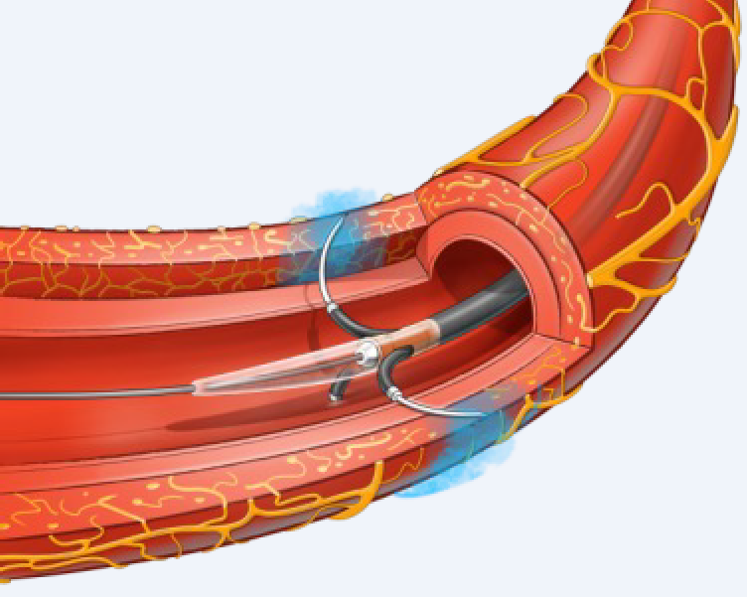
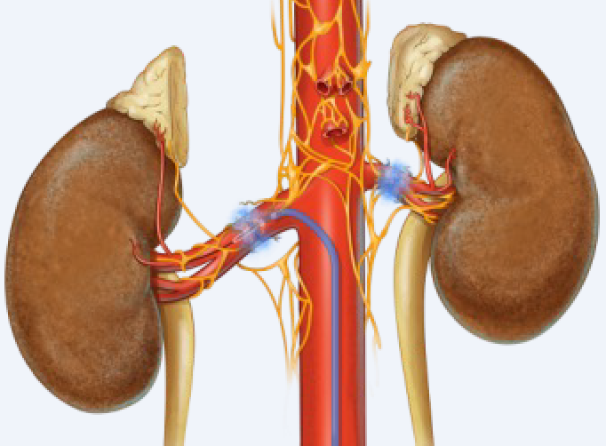
Alcohol-Mediated Renal Denervation
Perivascular Delivery of Alcohol to Adventitial Space
Expanded View of Device Infusing Alcohol
Site-specific delivery of alcohol: Local nerve inactivation, no collateral damage
Micro-volume (0.6 mL) infused directly to the perivascular region
Extracellular fluid helps spread alcohol circumferentially in the perivascular region
Alcohol activity range self-limited through dilution by extracellular fluid
Fischell et al. J Am Coll Cardiol Intv 2016

Slide 5
Prior Studies of Alcohol-Mediated RDN
Peregrine First In Human¹ N=17
OSBP Change From Baseline
Peregrine Post-Market Study³ N=45
OSBP Change from Baseline
1 Month 3 Months 6 Months
20
10
0
-10
-20
-30
-40
-50
30 Days 3 Months 6 Months
12 Months
0
-5
-10
-15
-20
-25
-30
-18 ± 21
-18 ± 22
-18 ± 21
-20 ± 23
mmHg
-25
± 27
-15 ± 30
-22
± 20
mmHg
p=0.002 p=0.06
Target BP OFF MED² N=106
p<0.001
p<0.001
p<0.001 p<0.001
ABPM Change from Baseline
3 Months 6 Months
p=0.001
2
1
0
-1
-2
-3
-4
-5
2
1
0
-1
-2
-3
-4
-5
1 Month
12 Months
24 h ABP Change from Baseline at 8 weeks
OBP Change from Baseline at 8 weeks
0
-5
-10
-15
-20
-25
-30
-9 ± 13
-10 ± 12
-11 ± 14
-10 ± 17
-2.9
±7.4
-1.4
-2.0
±5.1
-1.1
±6.6
-4.0
±12.6
0.63
±13.2
-3.5
±7.6
-1.1
±8.6
±8.8
mmHg
Δ -1.5 mmHg p=0.2682
24 h ASBP
Δ -0.94 mmHg p=0.4734
Δ -4.6 mmHg p=0.0605
OSBP
Δ -2.3mmHg p=0.1843
ODBP
24 h ADBP
p<0.001
p<0.001
p<0.001
p=0.001
RDN
Sham Control
Fischell et al. Cardiovasc Revasc Med 2015
Pathak et al. EuroIntervention 2023
Mahfoud et al. Circ Cardiovasc Interv 2021

Slide 6
TARGET BP I
Study Design
Screening & Run-In Period
Randomization
Post-Treatment Follow-Up
Primary Efficacy Endpoint
M 3
Office BP 24H ABPM Drug Testing
M 3
Treatment Arm: Renal Denervation
Weeks 4 & 8
M 4/5
M 6
Year 1/2/3
OSBP ≥150 and ≤180 mmHg ODBP ≥90 mmHg
ASBP ≥135 and <170 mmHg
N=148
Office BP
Office BP
Office BP 24H ABPM
Drug Testing Vascular Safety
Office BP 24H ABPM
Screening
4-week Run-In
1:1
N=301
Drug Testing Week -1
Unblinding Crossover
INCLUSION CRITERIA
Stable regimen of 2-5 anti-HTN meds including diuretic*
Renal artery diameter between 3 and 7 mm
EXCLUSION CRITERIA
N=153
Sham Control Arm: Renal Angiography
Weeks 4 & 8
M 4/5
M 6
Secondary cause of hypertension
Type 1 or uncontrolled type 2 DM
eGFR ≤45 mL/min/1.73 m² (per CKD-EPI)
History of MI, unstable angina pectoris, or stroke/TIA in prior 6 months
Heart failure (NYHA III or IV) or EF ≤30%
Chronic AF
Stable regimen of anti-HTN medications
Addition of HTN medications (if required) according to specific criteria and titration
*Diuretic therapy required unless documented intolerance

Slide 7
TARGET BP I
Patient Flow Chart
Enrolled patients with HTN May 2019 to April 2023 n=1414
Screen failures n=1113
BP criteria not met n=669 Anatomic criteria not met n=136 Other: n=308
Randomized n=301
Renal denervation n=148
ITT population
Sham Control n=153
ITT population
3-month follow-up completed
n=143 (96.6%)
3-month follow-up completed
n=148 (96.7%)

Slide 8
TARGET BP I
Baseline Patient Characteristics
 | RDN (N=148) | Sham (N=153) |  |  | RDN (N=148) | Sham (N=153)
Age | 56.7 ± 10.0 | 55.6 ± 9.1 |  | Race*
Male | 113 (76.4%) | 111 (72.5%) |  | White | 45 (30.4%) | 42 (27.5%)
Body-mass index (kg/m²) | 32.6 ± 5.3 | 32.1 ± 5.3 |  | Black/African American | 23 (15.5%) | 30 (19.6%)
Chronic kidney disease (eGFR <60 mL/min per 1.73m²) | 15 (10.1%) | 20 (13.1%) |  | Asian | 0 | 2 (1.3%)
Type 2 diabetes | 30 (20.3%) | 40 (26.1%) |  | Not reported | 80 (55.1%) | 79 (51.6%)
History of arrhythmia | 14 (9.5%) | 11 (7.2%) |  | Number of anti-HTN medications
History of congestive heart failure | 7 (4.7%) | 8 (5.2%) |  | 2 | 32 (21.6%) | 35 (22.9%)
Smoking (current) | 14 (9.5%) | 20 (13.1%) |  | 3 | 48 (32.4%) | 40 (26.1%)
Hyperlipidemia | 57 (38.5%) | 74 (48.4%) |  | 4 | 41 (27.7%) | 43 (28.1%)
 |  |  |  | ≥5 | 27 (18.2%) | 34 (22.2%)
ITT population; data represented as N (%) or mean ± SD
*Information on race was not allowed to be collected by law in certain countries
Aldosterone antagonist use 23 (15.5%) 35 (22.9%)

Slide 9
TARGET BP I
Baseline Blood Pressure and Heart Rate Measures
 | RDN (N=148) | Sham (N=153)
Office Measurements Office Systolic BP | 164 ± 9 | 164 ± 9
Office Diastolic BP | 98 ± 7 | 100 ± 7
24-hour Ambulatory Measurements
Mean 24-hour Systolic BP | 146 ± 9 | 146 ± 8
Mean 24-hour Diastolic BP | 87 ± 8 | 88 ± 9
Heart Rate (bpm)
75 ± 12
75 + 14
Data represented as mean ± standard deviation

Slide 10
TARGET BP I
Procedural Characteristics
RDN (N=150)
Sham (N=151)
Total procedure time (min)
55.7 ± 27.0 (150)
33.7 ± 24.1 (151)
Total volume contrast (mL)
95.7 ± 47.4 (150)
40.0 ± 22.6 (151)
Total fluoroscopy time (min)
10.8 ± 7.7 (150)
3.1 ± 2.8 (151)
Device success
143 (95.3%)
—
Procedure success
139 (92.7%)
—
Number arteries treated/patient
2.2
—
Data represented as mean ± standard deviation (N) or N (%)

Slide 11
TARGET BP I
Primary Endpoint: 24-hr ASBP at 3 Months
0
24 h ASBP Change at 3 Months (mmHg)
-2
RDN N=148
-4
Sham Control N=153
-6
-6.8 ± 12.1 mmHg
-8
-10
-10.0 ± 14.2 mmHg
-12
Δ -3.2 mm Hg
-14
(95% CI -6.3 to 0.0) P=0.049
24 h ASBP

Slide 12
TARGET BP I
Ambulatory and Office Systolic BP at 3 Months
AM B U L AT O R Y S B P
Nighttime
OF F I C E S B P
24H
Daytime
OBP
RDN N=148
-6.0 ± 14.4
Sham N=153
-6.8 ± 12.1
-7.1 ± 11.7
-9.3 ± 14.8
-9.7 ± 17.3
-10.0 ± 14.2
-10.1 ± 13.6
-12.7 ± 18.3
-3.2 mmHg
(95% CI -6.3 to 0)
(P=0.049)
-3.3 mmHg
(95% CI -6.6 to 0)
(P=0.068)
-3.0 mmHg
(95% CI -5.8 to -0.1)
(P=0.057)
-3.0 mmHg
(95% CI -7.0 to 1.0)
(P=0.173)

Slide 13
TARGET BP I
Ambulatory and Office Diastolic BP at 3 Months
AM B U L AT O R Y D B P
OF F I C E D B P
0
-1
RDN N=148
-2
-3
Sham N=153
-4
-4.1 ± 0.6
-5
-6
-5.4 ± 0.7
-6.1 ± 9.7
-7
Δ -1.4 mmHg
-6.9 ± 9.4
(95% CI -3.1 to 0.3)
P=0.12
-8
Δ -0.78 mmHg
(95% CI -2.95 to 1.38)
P=0.31

Slide 14
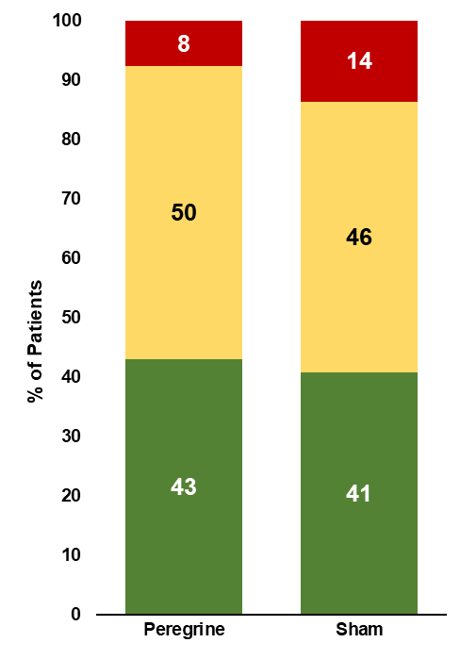
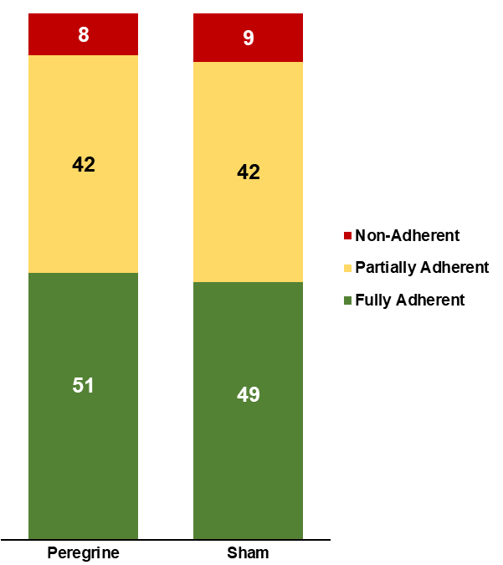
TARGET BP I
Prescription Changes and Adherence Results
Changes in Antihypertensive Medication Prescription Through 3 Months
Adherence to Antihypertensive Medications
100
5
5
90
80
70
60
% of Patients
50
92
93
Increase
No Change
40
Decrease
30
20
10
0
3
2
Peregrine
Sham
RDN
RDN
RDN
Counts are by patient visit; not individual medications or dose Excludes subject visit compliance results that are not available
Baseline
3 Months

Slide 15
TARGET BP I
3-Month 24-hr ASBP Subgroup Analyses

Slide 16
TARGET BP I
Safety Outcomes
 |  | 30 Days |  |  | 6 Months
 | RDN (N=149) | Sham (N=150) | P value | RDN (N=145) | Sham (N=146) | P value
Total Major Adverse Events | 7 (4.7%) | 0 | 0.007 | 11 (5.3%) | 6 (4.0%) | 0.22
All Cause Death | 0 | 0 | — | 1 (0.7%) | 0 | 0.50
Myocardial Infarction | 0 | 0 | — | 1 (0.7%) | 1 (0.7%) | 1.00
Major Vascular Complication | 1 (0.7%) | 0 | 0.50 | 1 (0.7%) | 0 | 0.50
Hypertensive Emergency | 1 (0.7%) | 0 | 0.50 | 2 (1.4%) | 2 (1.4%) | 1.00
Hypotension* | 6 (4.0%) | 0 | 0.02 | 7 (4.8%) | 3 (2.0%) | 0.22
eGFR (mL/min/1.73m²) |  |  |  | -1.2 ± 9.9 (138) | -0.86 ± 9.0 (146) | 0.73
Change ± SD (N)
Vessel Safety
Patency (<60% stenosis)
99.6%
(280 vessels)
—
—
*Hypotension requiring intervention or medication change

Slide 17
TARGET BP I
Limitations
High rates of medication nonadherence both at baseline and follow-up
⎼ No significant differences between groups relative to medication increase/decrease or general adherence
⎼ Inability of current methods to assess changes in medications within same class or timing of last administration
Potential influence of home BP assessment uncertain
Findings limited to 3 months follow-up, and whether progressive declines in BP occur over later follow-up indeterminate
No procedural assessment regarding completeness of denervation
Results observed with this therapy and in this specific population may not be generalizable to alternative interventional therapies for hypertension and more varied clinical populations

Slide 18
TARGET BP I
Conclusions
In this sham-controlled, randomized trial inclusive of patients with both uncontrolled and treatment resistant HTN, alcohol-mediated RDN met its primary endpoint, with a modest but significant decrease in 24-hr ambulatory SBP at 3-month follow-up
⎼ Results consistent across both day/night ABPM and prespecified subgroups
No significant between group differences were observed relative to office blood pressure assessments
RDN results observed in context of large BP reductions in sham control cohort
⎼ Strikingly high rates of partial and complete nonadherence
Alcohol-mediated RDN associated with favorable procedural performance and intermediate-term safety
Ongoing, dedicated late-term follow-up will be important to inform the effectiveness as a treatment for uncontrolled HTN

Slide 19
EFFECT OF ALCOHOL-MEDIATED RENAL DENERVATION ON BLOOD
PRESSURE IN THE PRESENCE OF ANTIHYPERTENSIVE MEDICATIONS: PRIMARY RESULTS FROM THE TARGET BP I RANDOMIZED CLINICAL TRIAL
CIRCULATION. 2024; [PUBLISHED ONLINE AHEAD OF PRINT]. DOI: 10.1161/CIRCULATIONAHA.124.069291
DAVID E. KANDZARI, MD; MICHAEL A. WEBER, MD; ATUL PATHAK, MD, PHD; JAMES P. ZIDAR, MD; MANISH
SAXENA, MBBS; SHUKRI W. DAVID, MD; ROLAND E. SCHMIEDER, MD; ADAM J. JANAS, MD, PHD;
CHRISTOPHER LANGER, MD; ALEXANDRE PERSU, MD, PHD; FARRELL O, MENDELSOHN, MD; KOEN AMELOOT,
MD, PHD; MALCOLM FOSTER III, MD; TIM A. FISCHELL, MD; HELEN PARISE, SCD; FELIX MAHFOUD, MD, MA
CIRCULATION
HTTPS://WWW.AHAJOURNALS.ORG/DOI: 10.1161/CIRCULATIONAHA.124.069291
19

