Slide 1
FFR-Guided Complete or Culprit-Only PCI in Patients with Myocardial Infarction
Felix Böhm, MD, PhD
Karolinska Institute and Danderyd Hospital, Stockholm, Sweden On behalf of the FULL REVASC Trial Executive and Steering
Committees and Investigators

Slide 3
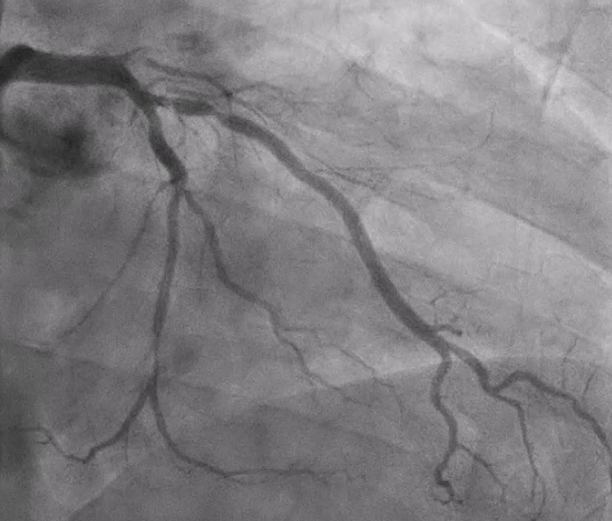
Culprit
Non-culprit?
Tonino et al, NEJM, 2009
De Bruyne et al, NEJM, 2014
Zimmerman et al, Eur Heart J. 2015
Wald et al, NEJM 2013
Gershlick et al, JACC 2015
Engstrom et al, Lancet 2015
Smits et al, NEJM 2017

Slide 5
N=1542 patients
Primary PCI of STEMI/Pharmacoinvasive PCI for STEMI/very-high-risk NSTEMI
Exclude: Previous CABG Left main disease Cardiogenic chock
≥ 1 non-culprit lesions
Visual estimation
non-culprit vessel at least
2.5 mm on angiography (50-99%) amenable for PCI
1:1
Randomization
<6 h from index PCI
FFR-guided PCI of non-culprit lesions
during index hospitalization
Initial conservative management of non-culprit lesions
N=764
N=778
Median follow-up 4.8 years
Primary endpoint: Death, MI or Unplanned Revascularization

Slide 6
Sweden 796 patients
Data collected as part of routine clinical care
R-RCT
Web Application
FULL REVASC
database
Denmark 331
Serbia 318
Finland 64
Commercial electronic data capture system
Latvia 14
Australia 13
New Zealand 6

Slide 8
 | Complete N=764 | Culprit-only N=778
Age (yrs) | 65.0 | 65.7
Female sex (%) | 21.3 | 26.0
BMI (kg/m²) | 27.6 | 27.6
Diabetes (%) | 16.0 | 16.3
Prior MI (%) | 9.5 | 6.8
Current smoker (%) | 35.8 | 33.6
Hypertension (%) | 50.3 | 52.2
Dyslipidemia (%) | 23.3 | 22.2
Prior PCI (%) | 9.3 | 8.1
Sx onset to Culprit PCI ≤6 h (%) | 71.4 | 74.6
6-12 h (%) | 16.1 | 14.4
>12 h (%) | 12.5 | 11.0
 | Complete N=764 | Culprit-only N=778
Killip class II-IV (%) | 4.6 | 4.8
ECG to Culprit PCI (h) | 1.13 | 1.12
Peak creatinine - µmol/L | 91.1 | 90.1
Discharge Meds (%)
Aspirin | 97.5 | 97.6
P2Y12 inhibitor
Any | 98.4 | 98.3
Ticagrelor | 88.9 | 87.1
Clopidogrel | 9.5 | 11.2
Beta blocker | 81.6 | 80.8
ACEi/ARB | 79.8 | 78.5
Statin | 97.6 | 96.9

Slide 9
 | Complete N=764 | Culprit-only N=778
Age (yrs) | 65.0 | 65.7
Female sex (%) | 21.3 | 26.0
BMI (kg/m²) | 27.6 | 27.6
Diabetes (%) | 16.0 | 16.3
Prior MI (%) | 9.5 | 6.8
Current smoker (%) | 35.8 | 33.6
Hypertension (%) | 50.3 | 52.2
Dyslipidemia (%) | 23.3 | 22.2
Prior PCI (%) | 9.3 | 8.1
Sx onset to Culprit PCI ≤6 h (%) | 71.4 | 74.6
6-12 h (%) | 16.1 | 14.4
>12 h (%) | 12.5 | 11.0
 | Complete N=764 | Culprit-only N=778
Killip class II-IV (%) | 4.6 | 4.8
ECG to Culprit PCI (h) | 1.13 | 1.12
Peak creatinine - µmol/L | 91.1 | 90.1
Discharge Meds (%)
Aspirin | 97.5 | 97.6
P2Y12 inhibitor
Any | 98.4 | 98.3
Ticagrelor | 88.9 | 87.1
Clopidogrel | 9.5 | 11.2
Beta blocker | 81.6 | 80.8
ACEi/ARB | 79.8 | 78.5
Statin | 97.6 | 96.9

Slide 10
 | Complete N=764 | Culprit-only N=778
Indication for PCI (%)
STEMI - Primary | 88.2 | 88.7
STEMI - Pharmacoinvasive | 2.7 | 3.2
Very-high-risk NSTEMI | 9.0 | 8.1
Radial access (%) | 93.2 | 93.4
Residual diseased vessels
1 | 73.8 | 70.6
≥2 | 26.2 | 29.4
Non-Culprit Lesion Location
Left main | 0.3 | 0.3
LAD | 51.4 | 56.0
Proximal LAD | 21.1 | 20.2
Circumflex | 44.2 | 43.2
RCA | 30.1 | 29.9
 | Complete N=764 | Culprit-only N=778
Non-culprit lesion stenosis (%)
50-69% | 34.9 | 41.8
70-89% | 47.6 | 42.2
90-99% | 17.3 | 15.9
100% (+ other NCL) | 5.5 | 4.5
Number of stents (median) | 2.0 | 1.0
Total stent length (median) | 43.0 | 28.0
Largest stent Ø (median) | 4.0 | 3.0
FFR ≤0.80 in NCL (%) | 47.3
Any vessel with FFR≤0.80 per patient (%) | 60.3
Lowest FFR per patient | 0.76
PCI in NCL if FFR≤0.80 (%) | 94.1

Slide 11
 | Complete N=764 | Culprit-only N=778
Indication for PCI (%)
STEMI - Primary | 88.2 | 88.7
STEMI - Pharmacoinvasive | 2.7 | 3.2
Very-high-risk NSTEMI | 9.0 | 8.1
Radial access (%) | 93.2 | 93.4
Residual diseased vessels
1 | 73.8 | 70.6
≥2 | 26.2 | 29.4
Non-Culprit Lesion Location
Left main | 0.3 | 0.3
LAD | 51.4 | 56.0
Proximal LAD | 21.1 | 20.2
Circumflex | 44.2 | 43.2
RCA | 30.1 | 29.9
 | Complete N=764 | Culprit-only N=778
Non-culprit lesion stenosis (%)
50-69% | 34.9 | 41.8
70-89% | 47.6 | 42.2
90-99% | 17.3 | 15.9
100% (+ other NCL) | 5.5 | 4.5
Number of stents (median) | 2.0 | 1.0
Total stent length (median) | 43.0 | 28.0
Largest stent Ø (median) | 4.0 | 3.0
FFR ≤0.80 in NCL (%) | 47.3
Any vessel with FFR≤0.80 per patient (%) | 60.3
Lowest FFR per patient | 0.76
PCI in NCL if FFR≤0.80 (%) | 94.1

Slide 12
Complete N=764
Culprit-only N=778
Complete N=764
Culprit-only N=778
Indication for PCI (%)
Non-culprit lesion stenosis (%)
50-69% 34.9
70-89% 47.6
90-99% 17.3
STEMI - Primary
88.2
88.7
41.8
STEMI - Pharmacoinvasive
2.7
3.2
42.2
Very-high-risk NSTEMI
9.0
8.1
15.9
Radial access (%) 93.2 93.4
100% (+ other NCL) 5.5
4.5
Residual d
Complete revascularization was achieved in 94.1%
^{iseased vessels} Number of stents (median) 2.0
^{73.8 70.6} Total stent length (median) 43.0
26.2 29.4
1.0
1
after FFR-guided non-culprit lesion PCI
28.0
≥2
Non-Culprit Lesion Location
Largest stent Ø (median)
4.0
3.0
Left main
0.3
0.3
FFR ≤0.80 in NCL (%)
47.3
LAD
51.4
56.0
Any vessel with FFR≤0.80 per patient (%)
Proximal LAD
21.1
20.2
60.3
Circumflex
44.2
43.2
Lowest FFR per patient
0.76
RCA
30.1
29.9
PCI in NCL if FFR≤0.80 (%)
94.1

Slide 13
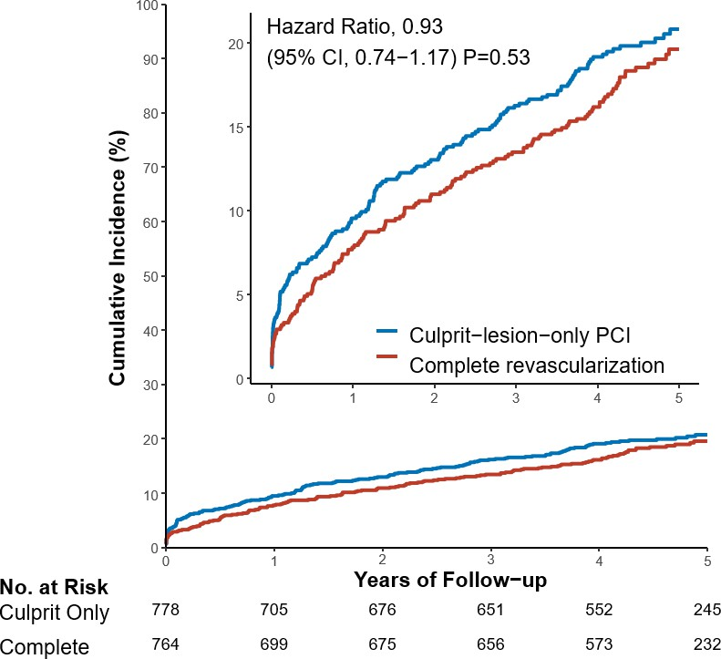

Slide 14
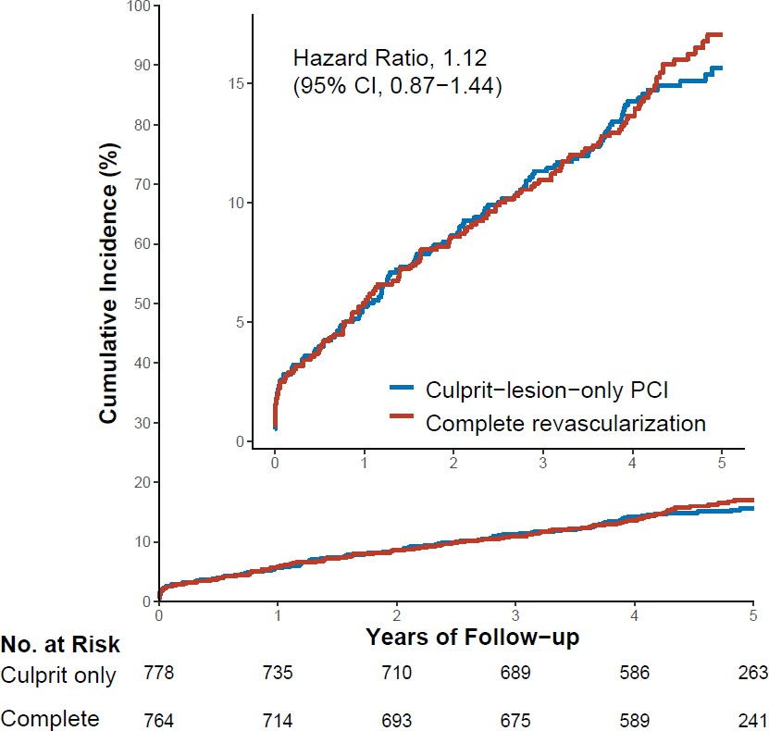
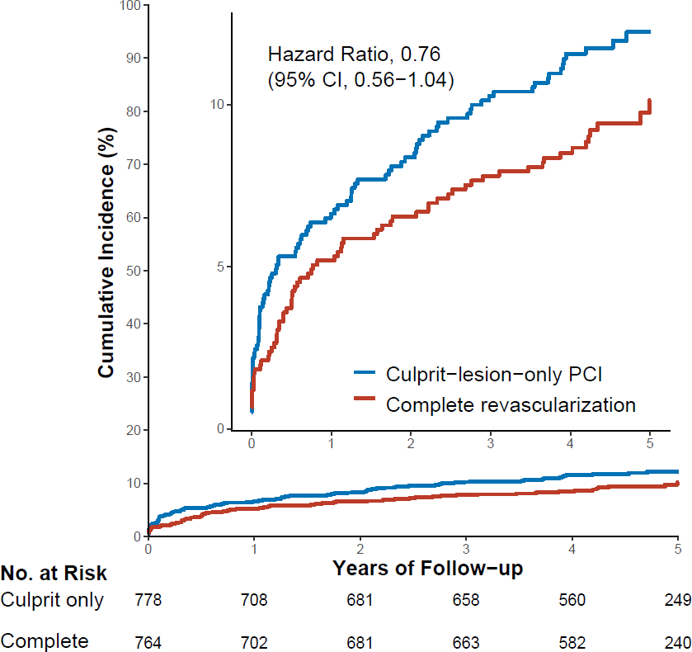

Slide 15
Outcome | Complete (N = 764) | Culprit only (N = 778) | Hazard Ratio (95% CI) | P-value
 | number of patients (%)
Primary outcome
Death, MI, or unplanned revascularization | 145 (19.0) | 159 (20.4) | 0.93 (0.74-1.17) | 0.93
Key secondary outcomes
Death or myocardial infarction | 126 (16.5) | 119 (15.3) | 1.12 (0.87-1.44) | 0.37
Unplanned revascularization | 70 (9.2) | 91 (11.7) | 0.76 (0.56-1.04) | 0.092
Other secondary outcomes
Death from any cause | 76 (10.0) | 72 (9.3) | 1.15 (0.83-1.58) | 0.41
Death from cardiovascular causes | 32 (4.2) | 40 (5.1) | 0.87 (0.55-1.39) | 0.56
Myocardial infarction | 61 (8.0) | 58 (7.5) | 1.09 (0.76-1.57) | 0.62
Any revascularization (planned or unplanned) | 78 (10.2) | 128 (16.5) | 0.59 (0.45-0.78) | 0.00027
CV death, MI, or unplanned revascularization | 104 (13.6) | 132 (17.0) | 0.80 (0.62-1.03) | 0.085

Slide 16
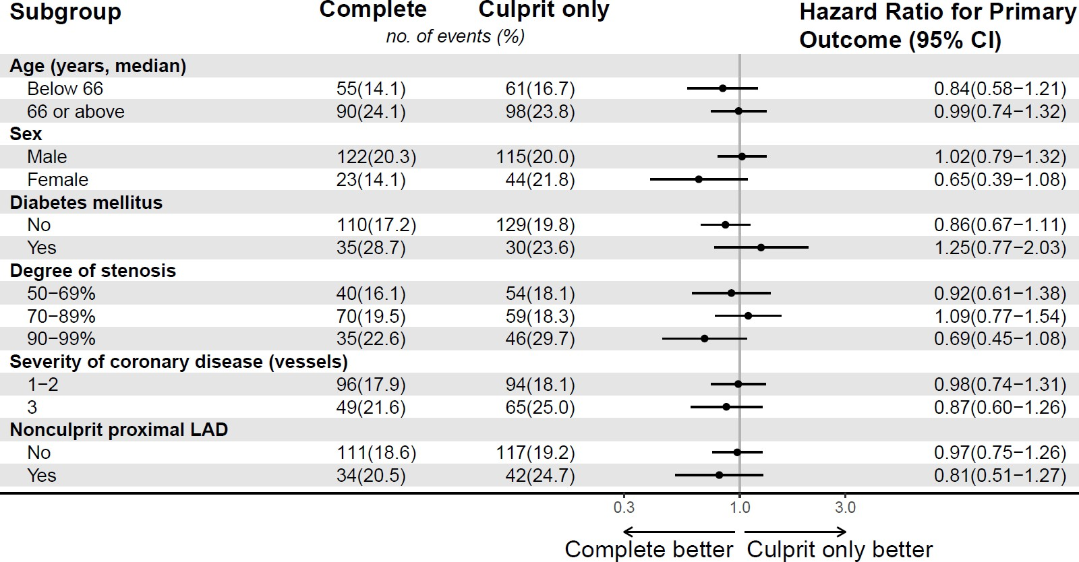

Slide 17
Outcome | Complete (N = 764) | Culprit only (N = 778) | Hazard Ratio (95% CI) | P-value
 | number of patients (%)
Stent thrombosis | 19 (2.5) | 7 (0.9) | 2.80 (1.18-6.67) | 0.02
Restenosis | 32 (4.2) | 18 (2.3) | 1.84 (1.03-3.28) | 0.039
Target vessel revascularization | 66 (8.6) | 43 (5.5) | 1.57 (1.07-2.31) | 0.021
Contrast-associated acute kidney injury | 89 (11.7) | 91 (11.8) | 0.99 (0.73-1.35) | 0.96
Stroke | 22 (2.9) | 22 (2.8) | 1.03 (0.57-1.87) | 0.91
Major bleeding | 19 (2.5) | 17 (2.2) | 1.18 (0.61-2.28) | 0.61
Rehospitalization for heart failure | 23 (3.0) | 26 (3.3) | 0.97 (0.55-1.70) | 0.92

Slide 18
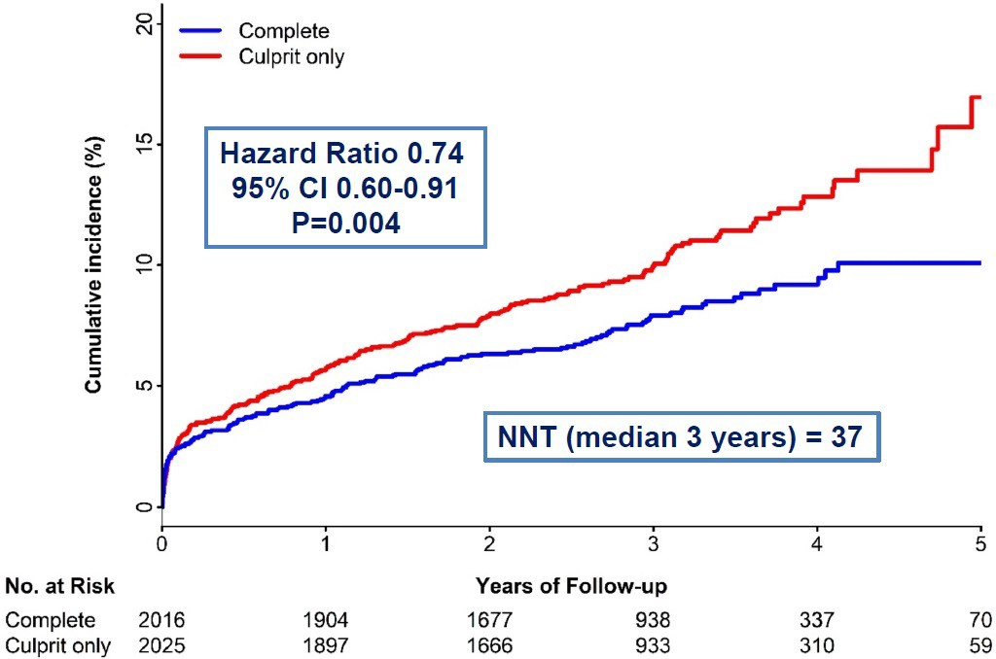
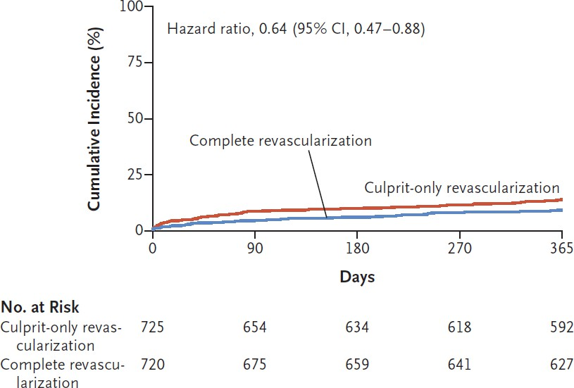
Mehta et al, NEJM, 2019
Biscaglia et al, NEJM, 2023

Slide 20
Executive Committee Felix Böhm, Study PI Stefan James, Study Chair
Thomas Engstrøm, NC Denmark Goran Stankovic, NC Serbia Andreas Rück, NC Sweden Oscar Angerås, Sweden
Mika Laine, NC Finland Andrejs Ērglis, NC Latvia Carl Schultz, NC Australia
Madhav Menon, NC New Zealand
International Steering Committee
Executive Committe and:
Daniel Wadell
UCR Central Coordinating Center
Azar Pettersson, Ulla Nässander Schikan, Susanne Johansson, Anna Stendahl, Åsa Michelgård Palmquist, Ollie Östlund, Henrik Renlund, Karin Jensevik Eriksson, Manuela Zamfir, Åsa Eck, Kathrina Felix, David Karlsson, Stefano Caramuta, Malin Lundgren, Caroline Moberg, Malin Thoudal, Karin Renlund Grausne, Anna Dahlstedt, Lan Vu Thi, Vinaykoumar Kontham, Karolina Östlund, Ida Björkgren, Swanthe Lindgren, Malin Nord, Annika Edberg, Helena Pettersson, Susanna Thörnqvist, Rebecka Ekhamn, Matts Högberg, Sahid Hasan, Maria Eriksson-Svensson, Jonas Oldgren
Sammy Zwackman Dario Hauer Mehmet Hamid Fredrik Calais Thomas Kellerth Jörg Lauermann Jonas Andersson
Brynjölfur Mogensen Rickard Linder
Nils Witt
Robert Kastberg
Anders Ulvenstam Kristina Hambraeus Per Grimfjärd Martin Lindholm
Espen Haugen Bo Lindvall Daniel Ohm Oscar Winnberg Pontus Lindroos David Erlinge Leif Thuesen
Evald Høj Christiansen
Lisette Okkels Jensen Olli Kajander
Robert Masar Ilija Srdanovic
Aleksandar Neskovic
Barry Kneale
Data Monitoring Board
Nils Johnson, Bernard de Bruyne, William Fearon, Nico Pijls, Ollie Östlund
Sponsor Leadership Marcus Ståhlberg, Frieder Braunschweig, Per Mattsson, Anders Ahlsson,
Eva Wallgren, Raquel Binisi
Adjudication Committee
Claes Held (Chair), Kai Eggers, Christina Christersson, Nina Johnston, Christer Lidell, Kasper Andersen, Gabriel ArefalkRobert Sevcik, Gianluigi Savarese, Oscar Braun, Rickard Linder
We thank all investigators, study coordinators and participants
ClinicalTrials.gov number, NCT02862119. fullrevasc.se

Slide 21
FULL V REVASC
The NEW ENGLAND JOURNAL of MEDICINE
l l o_R_IG_I_N_A_L_A_R_T_ic_L E II
FFR-Guided Complete or Culprit-Only PCI in Patients with Myocardial Infarction
Felix Bohm, M.D., Ph.D., Brynjolfur Mogensen, M.D., Thomas Engstr0m, M.D., Ph.D., Goran Stankovic, M.D., Ph.D., llija Srdnaovic, M.D., Ph.D.,
Jacob L0nborg, M.D., Ph.D., Sammy Zwackman, M.D., Mehmet Hamid, M.D., Thomas l<ellerth, M.D.,Jorg Lauermann, M.D., Ph.D., Olli A. l<ajander, M.D., Ph.D., Jonas Andersson, M.D., Ph.D., Rikard Linder, M.D., Ph.D., Oskar Angeras, M.D., Ph.D., Henrik Renlund, Ph.D., Andrejs trglis, M.D., Ph.D., Madhav Menon, M.D.,
Carl Schultz, M.D., Ph.D., Mika Laine, M.D., Ph.D., Claes Held, M.D., Ph.D., Andreas Ruck, M.D., Ph.D., Ollie Ostlund, Ph.D., and Stefan James, M.D., Ph.D., for the FULL REVASC Trial Investigators.;',
� ' ..
l!l - •

