Slide 1

ROPAC - Pregnancy in women with cardiovascular disease: trends in outcome from 10 years ESC Registry Of Pregnancy And Cardiac disease
Jolien Roos-Hesselink ErasmusMC, Rotterdam, Netherlands

Slide 2
ROPAC is part of the EURObservational Research Programme (EORP) of the ESC
Chairpersons
Prof Jolien Roos-Hesselink, Netherlands
Prof Roger Hall, UK
Coauthors
Drs Lucia Baris, Netherlands
Prof Mark Johnson, UK
Dr Julie de Backer, Belgium
Prof Catherine Otto, USA
Prof Ariane Marelli, Canada
Prof Guillaume Jondeau, France
Dr Jasmine Grewal, Canada
Prof Werner Budts, Belgium
Prof Karen Sliwa, South Africa
Dr William Parsonage, Australia
Dr Aldo Maggioni, Italy
Drs Iris van Hagen, the Netherlands
Prof Alec Vahanian, France
Prof Luigi Tavazzi, Italy
Prof Uri Elkayam, US
Prof Eric Boersma, Netherlands

Slide 3
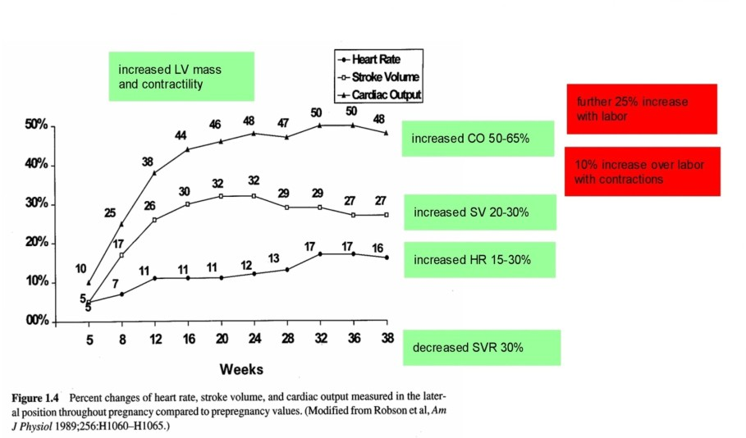
Hemodynamic impact of pregnancy

Slide 4
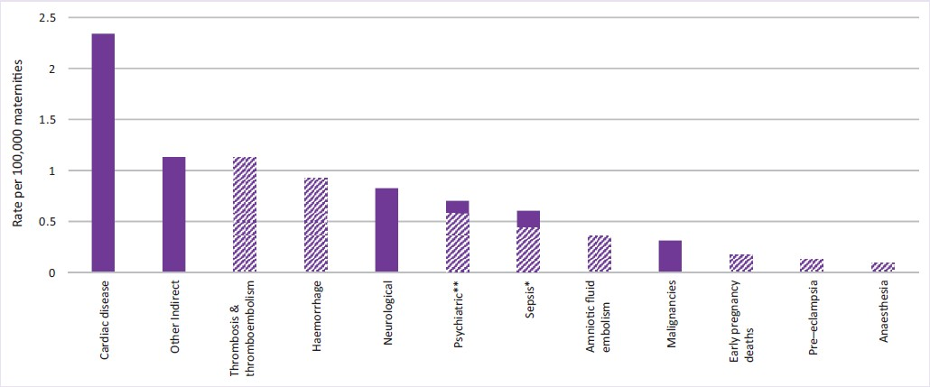
Maternal mortality by cause
MBRRACE-UK

Slide 5
Goals ROPAC
Assess risks for both mother and child
Outline variation between different regions
Support guidelines
Ultimate goal: reduce maternal mortality
5

Slide 6
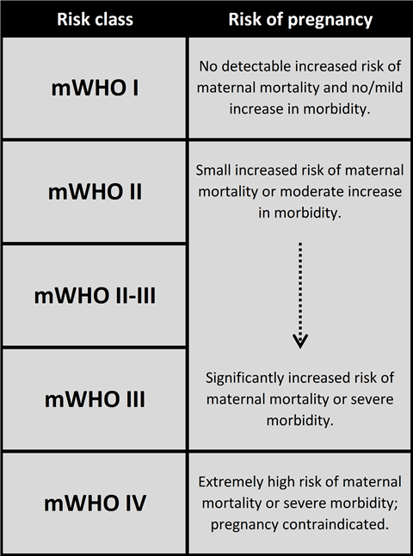
Risk stratification:
Modified WHO classification
ESC Guidelines on the management of cardiovascular diseases during pregnancy. 2018.

Slide 7
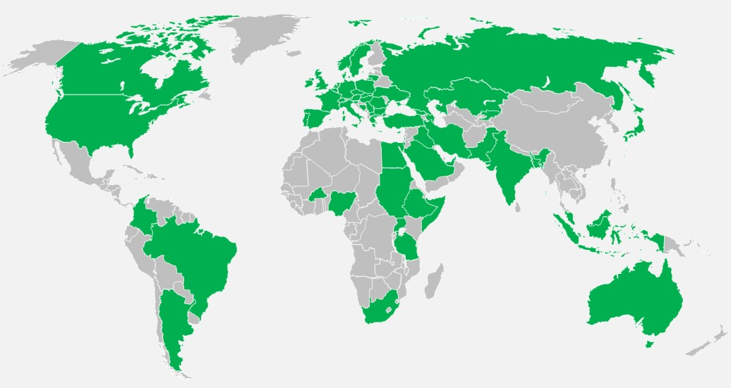
Prospective inclusion in ROPAC from 2007-2018 138 participating centres, 53 countries
5739 pregnancies

Slide 8
Diagnoses
2%
1%
4%
Congenital heart disease
8%
Valvular heart disease
Cardiomyopathy
Ischemic heart disease
29%
56%
Aortic pathology
Pulmonary arterial hypertension

Slide 9
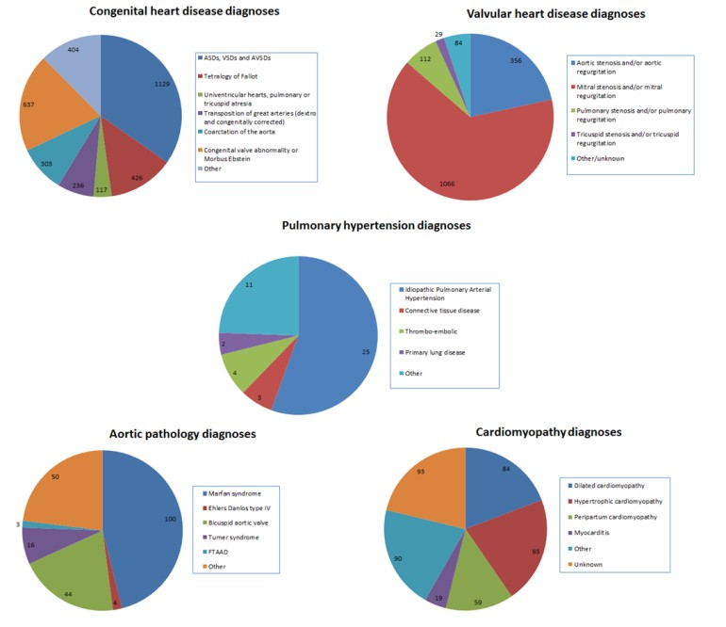
Diagnoses in detail

Slide 10
Outcome: Events
ROPAC 0.6%
11%
2%
2%
3%
44%
1%
1%
16%
Normal
0.007%
<0.1%
<0.5%
<0.5%
4%
23%
0.35%
0.4%
8%
P-value
<0.001
0.002
<0.05
<0.05
0.50
0.005
<0.001
0.12
0.06
Mortality
Heart failure Supravenriculair tachycardia Ventricular tachycardia
(Pre-)eclampsia Caesarean section Fetal mortality Neonatal mortality Premature birth
10

Slide 11
Cardiovascular outcomes per diagnosis group
35%
30%
25%
20%
15%
10%
5%
0%
Mortality Heart failure Arrhythmias
Cardiomyopathy
Aortic pathology
Congenital heart disease
Valvular heart disease
Ischemic heart disease
Pulmonary arterial hypertension

Slide 12
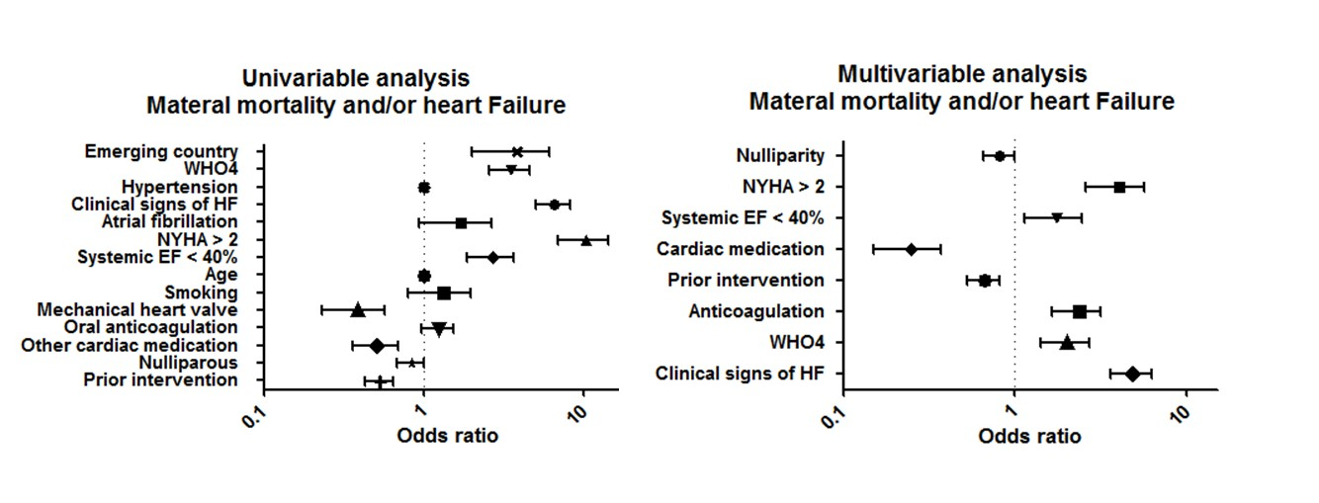
Pre-pregnancy predictors for maternal mortality and/or heart failure
12

Slide 13
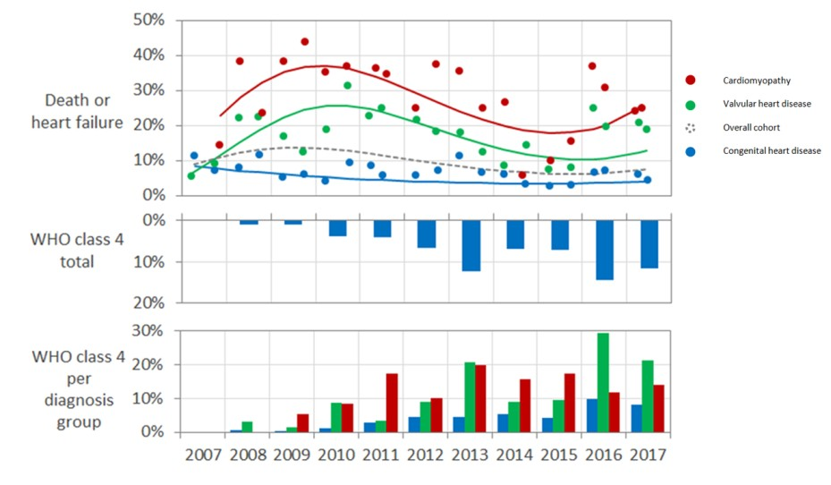
Trends over time
15

Slide 14
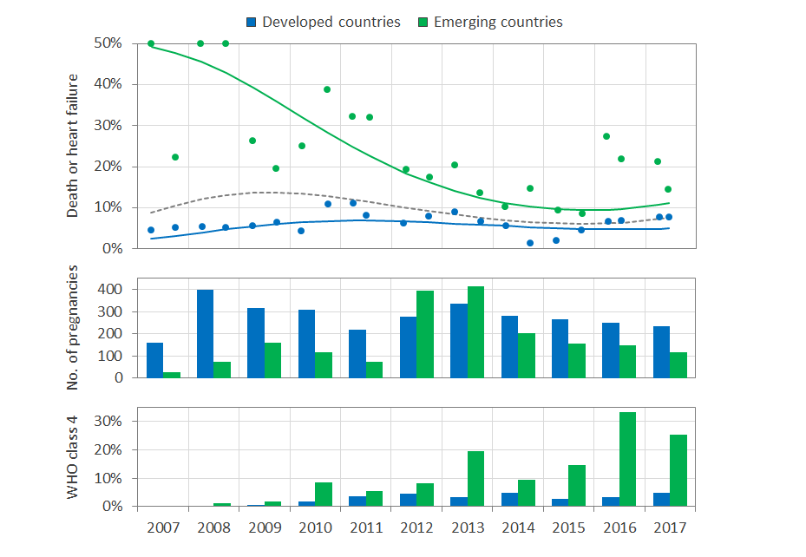
Variation between developed and emerging countries
15

Slide 15
Pregnancy outcome per mWHO category
Pregnancy outcomes per mWHO category
70%
60%
50%
40%
30%
20%
10%
Percentage
0%
Maternal
Caesarean
Post-partum
Neonatal
Premature
Heart failure
tal mortality
 | mortality |  | section | hemorrhage ^{Fe} |  | mortality | birth
mWHO I (n=1185) | 0% | 5% | 36% | 2% | 1% | 1% | 13%
mWHO II (n=828) | 0% | 5% | 36% | 1% | 1% | 1% | 12%
mWHO II-III (n=2698) | 1% | 12% | 46% | 3% | 1% | 0% | 15%
mWHO III (n=593) | 0% | 7% | 48% | 8% | 3% | 1% | 22%
mWHO IV (n=407)
3%
33%
60%
4%
2%
1%
28%
15

Slide 16
Obstetric and fetal outcomes per diagnosis group
Obstetric and fetal outcomes per diagnosis group
60%
50%
40%
Percentage
30%
20%
10%
0%
CHD (n=3295) VHD (n=1648)
CMP (n=428)
IHD (n=95)
AOP (n=217)
PAH (n=45)
Obstetric complications | 16% | 18% | 23% | 22% | 18% | 24%
Fetal and neonatal complications | 18% | 20% | 31% | 28% | 28% | 53%
15

Slide 17
Conclusions
Maternal mortality in women with cardiac disease is 100x higher then expected with highest mortality in women with pulmonary arterial hypertension (9%)
However, many women can go through pregnancy at low risk: counseling!
Heart failure is the most common complication, occurring in 11%, most prevalent in cardiomyopathy and pulmonary arterial hypertension
After an initial increase there is now a decline in maternal mortality and heart failure, despite more women being in the highest mWHO category
Improvement was observed mainly in emerging countries
Caesarean section was used often (44%) in women with cardiac disease, although not advised in the guidelines.
15

Slide 18
Future: ROPAC will continue in 2 focussed areas
Aortic Pathology
Prosthetic Valve
www.escardio.org/EORP eorp@escardio.org j.roos@erasmusmc.nl
Thank you for the attention
18

