Slide 1
Intravascular Ultrasound-guided vs Angiography-guided PCI in Acute Coronary Syndromes: The randomized IVUS-ACS trial
Shao-Liang Chen, MD
Nanjing Medical University and Nanjing First Hospital
on behalf of Gregg W. Stone MD and the IVUS-ACS Investigators
Twitter: @Shao_Liang Chen
ClinicalTrials.gov number: NCT03971500

Slide 2
Shao-Liang Chen has received speaker honoraria from Microport, Pulnovo, Boston International Scientific, Medtronic, Sanofi, and BioMed, and grants from the National Scientific Foundation of China, Jiangsu Provincial & Nanjing Municipal Clinical Trial Project.

Slide 3
Only three small dedicated RCTs of intravascular imaging-guided vs angiography-guided PCI in patients with ACS have been done (all with OCT guidance), with inconclusive results
No dedicated RCT of IVUS-guided PCI vs angiography- guided PCI in patients with ACS has been performed

Slide 4
To investigate whether IVUS guidance compared with angiography guidance for implantation of 2nd generation DES results in fewer clinical events in patients presenting with ACS

Slide 5
Patients presenting with ACS within 30 days before randomization
≥18 years of age
With either:
- Biomarker pos NSTEMI or STEMI
or
- Biomarker neg unstable angina
DS ≥90%, or
Ruptured plaque, or
Thrombotic lesion

Slide 6
Stroke within 3 months or any permanent neurologic deficit
Previous CABG
Any planned surgery within 12 months
eGFR <20 ml/min/1·73 m²
Need for chronic oral anticoagulation
Life expectancy <1 year
Any condition likely to interfere with study processes

Slide 7
Primary endpoint:
-- 1-year composite of target-vessel failure (TVF;
cardiac death, target-vessel MI, or clinically-driven TVR)
Secondary endpoints:
-- TVF without procedural MI
-- Individual components of the primary endpoint (TVF)
-- Stent thrombosis

Slide 8
Estimated 1-year rate of TVF with angiography-guided
PCI of 10.0%
28% risk reduction in TVF with IVUS-guided PCI
Expected drop-out rate of 5%
2-sided α of 0.05
Randomizing 3486 patients provides 80% power

Slide 9
Investigator-sponsored study
Steering Committee Shao-Liang Chen, MD Gregg W Stone, MD Imad Sheiban, MD Afsar Raza, MD Muhammad Anjum, MD
Country Leaders
Imad Sheiban, MD (Italy)
Afsar Raza, MD (United Kingdom)
Muhammad Anjum, MD (Pakistan) Zhiming Wu, MD (China)
Funding
Chinese Society of Cardiology [CSCF 2019-A0003], the National Natural Scientific Foundation of China [NSFC, grant number: 91639303, 81770441, and 82121001] and Jiangsu Provincial & Nanjing Municipal Clinical Trial Project [BE 2019615]. Stents were supplied by Medtronic and Microport.
Shao-Liang Chen, MD, Nanjing First Hospital, China
Executive Committee
Shao-Liang Chen, MD (Study chair and PI) Gregg W Stone, MD (Study co-chair and co-PI)
Jing Kan, MD (Chair of Clinical Data Coordinating Center)
Jun-Jie Zhang, MD, PhD Afsar Razar, MD
Imad Sheiban, MD
Fei Ye, MD Ping Xie, MD

Slide 10
3505 patients with ACS who were referred for PCI using 2nd generation DES
Enrollment took place between August 20th, 2019 and October 27th, 2022 at 58 centers in China (n=52), Pakistan (n=4), the United Kingdom (n=1), and Italy (n=1)
First randomization
IVUS guidance group (N=1753)
Angio guidance group (N=1752)
Randomisation was stratified by diabetes status, sex, and site using dynamic minimization
OpticrossTM catheter (Boston Scientific)
1-month DAPT (ticagrelor + Aspirin)
Second randomization at 30-day, 1:1 ratio Ticagrelor + placebo vs. Ticagrelor + aspirin
Patients who were event free would be randomised to aspirin plus ticagrelor or placebo plus ticagrelor (2nd randomisation)
1713 underwent 2nd randomization 40 did not undergo 2nd randomization
1687 underwent 2nd randomization 65 did not undergo 2nd randomization
Patients and all personnel interacting with the patient after leaving the cath lab were blinded to randomised assignment
1 Lost-to follow-up
1753 included in the ITT analysis
1752 included in the ITT analysis

Slide 11
 |  | IVUS-guided PCI (n=1753) | Angiography-guided PCI (n=1752)
 | Age, years (median [IQR]) | 62 (54, 69) | 63 (54, 69)
 | Male sex, n (%) | 1285 (73.3) | 1299 (74.1)
 | Hypertension | 1103 (62.9) | 1089 (62.2)
 | Diabetes mellitus | 554 (31.6) | 551 (31.5)
 | Dyslipidemia | 1187 (67.7) | 1222 (69.8)
 | Heart failure | 111 (6.3) | 106 (6.1)
 | Presentation
 | Unstable angina | 699 (39.9) | 726 (41.4)
 | Non-STEMI | 570 (32.5) | 537 (30.7)
 | STEMI | 484 (27.6) | 489 (27.9)

Slide 12
 | IVUS-guided PCI (n=1753) | Angiography-guided PCI (n=1752) | p value
2 - or 3 - vessel disease, n (%) | 525 (29.9) | 544 (31.1) | 0.30
Number of lesions, n | 1 (1, 1) | 1 (1, 2) | 0.24
Unprotected left main | 80 (4.6) | 69 (3.9) | 0.52
Transradial access | 1689 (96.4) | 1689 (96.4) | 0.93
DES type
Resolute | 738 (42.1) | 741 (42.3) | 0.83
Firehawk | 904 (51.6) | 916 (52.3) | 0.58
Mixed | 111 (6.3) | 95 (5.4) | 0.45
Number of stents, n | 1 (1, 2) | 1 (1, 2) | <0.0001
Maximum stent diameter, mm | 3.20 ± 0.44 | 3.12 ± 0.45 | <0.0001
Total stent length, mm | 33 (24, 52) | 30 (23, 47) | <0.0001
Post-dilation performed, n (%) | 1699 (96.9) | 1631 (93.2) | <0.0001
Contrast media, mL | 150 (130, 190)* | 150 (120, 180) | <0.0001
Procedural time, min | 50 (35, 70) | 30 (20, 48) | <0.0001
*Median 13.1 mL more

Slide 13
 | IVUS-guided PCI (n=1753) | Angiography-guided PCI (n=1752) | p value
Baseline
Reference vessel diameter, mm | 2.98 (2.61, 3.36) | 3.00 (2.60, 3.40) | 0.17
Minimal lumen diameter, mm | 1.05 (0.65, 1.40) | 1.06 (0·65, 1.40) | 0.45
Diameter stenosis, % | 60.7 (52.9, 69.8) | 60.0 (52·5, 69.0) | 0.32
Lesion length, mm | 26.7 (18.3, 38.3) | 26.5 (18.3, 37.8) | 0.24
Post-procedure
Reference vessel diameter, mm | 3.17 (2.80, 3.62) | 3.13 (2.77, 3.55) | 0.11
Minimal lumen diameter, mm | 2.76 (2·38, 3.17) | 2.70 (2.34, 3.06) | 0.0007
Acute gain, mm | 1.77 (1.31, 2.26) | 1·69 (1.25, 2.21) | 0.0014
Diameter stenosis, % | 12.9 (6.5, 19.3) | 14·0 (7.9, 20.3) | 0.0005

Slide 14
20
Angiography-guided PCI IVUS-guided PCI
15
TVF (%)
10
Hazard ratio 0.55 (95% CI 0.41 – 0.74)
P = 0.0001
7.3%
5
4.0%
0
0
30
90
150 210
Follow-up (days)
270
330 365
Number at Risk
Angiography-guided PCI 1752 | 1697 | 1687 | 1677 | 1664 | 1655 | 1642 | 1625
IVUS-guidedPCI 1753 | 1709 | 1705 | 1704 | 1697 | 1691 | 1686 | 1681

Slide 15
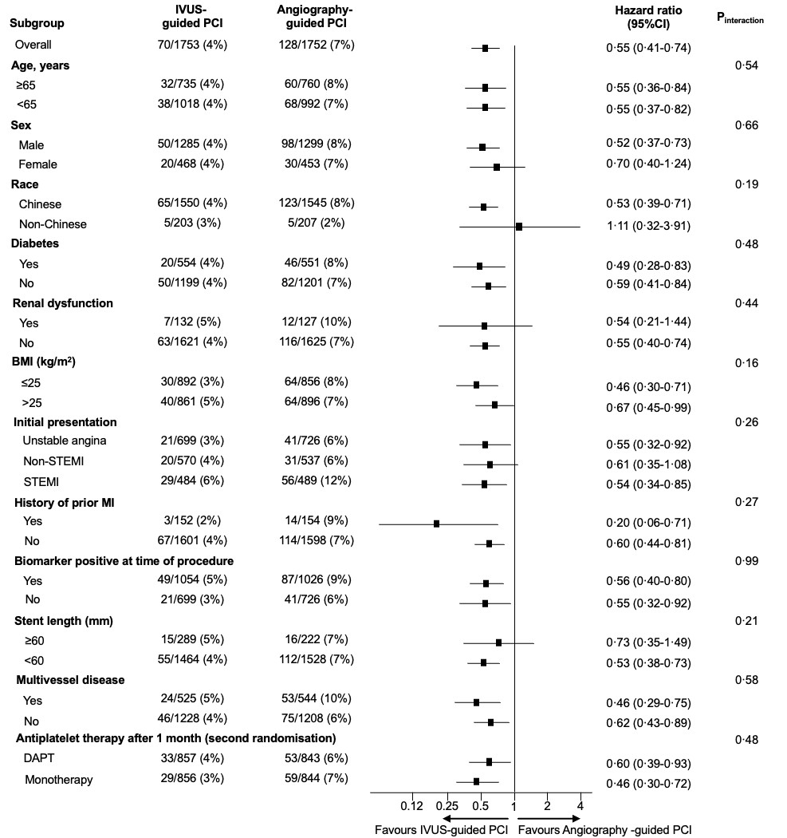

Slide 16
20
Angiography-guided PCI IVUS-guided PCI
TVF without procedural MI (%)
15
10
Hazard ratio 0.45 (95% CI 0.30 – 0.66)
P < 0.0001
5
5.1%
2.2%
0
0
30
90
150 210
Follow-up (days)
270
330 365
Number at Risk
Angiography-guided PCI 1752 | 1737 | 1727 | 1717 | 1704 | 1694 | 1681 | 1663
IVUS-guidedPCI 1753 | 1741 | 1737 | 1736 | 1729 | 1723 | 1718 | 1713

Slide 17
 | IVUS-guided PCI (n=1753) | Angiography- guided PCI (n=1752) | Hazard ratio (95% CI) | p value
Target-vessel failure, n (%) | 70 (4.0) | 128 (7.3) | 0.55 (0.41 – 0.74) | 0.0001
Cardiac death | 9 (0.5) | 20 (1.1) | 0.56 (0.24 – 1.29) | 0.17
Target-vessel MI | 44 (2.5) | 67 (3.8) | 0.63 (0.43 – 0.92) | 0.0176
Procedural MI | 34 (1.9) | 42 (2.4) | 0.78 (0.50 – 1.22) | 0.28
Spontaneous MI | 11 (0.6) | 26 (1.5) | 0.41 (0.20 – 0.84) | 0.0143
Clinically-driven TVR | 24 (1.4) | 56 (3.2) | 0.44 (0.27 – 0.72) | 0.0010
Clinically-driven TLR | 22 (1.3) | 44 (2.5) | 0.52 (0.31 – 0.88) | 0.0141
Definite or probable ST | 10 (0.6) | 16 (0.9) | 0.82 (0.35 – 1.90) | 0.64

Slide 18
Target criteria for optimal IVUS
20
Angiography-guided PCI
Sub-optimal IVUS-guided PCI Optimal IVUS-guided PCI
Non-left main lesions:
MSA >5.0 mm² or >90% of the MLA at the distal reference segment; and
plaque burden <55% within 5 mm
proximal or distal to the stent edge; and
absence of medial dissection >3
mm in length.
Left main lesions:
MSA >10 mm² for the left main segment, >7 mm² for the ostial/proximal LAD and >6 mm² for the ostial/proximal LCX (if stented).
In the IVUS group, optimal post-PCI IVUS criteria were met in 1392 of 1743 (79.9%) patients
15
TVF (%)
10
7.3%
7.1%
5
3.2%
0
0 30
90
150 210
Follow-up (days)
270
330 365
Number at Risk
Angiography-guided PCI | 1752 | 1697 | 1687 | 1677 | 1664 | 1655 | 1642 | 1625
Optimal IVUS-guided PCI | 1392 | 1363 | 1361 | 1361 | 1357 | 1353 | 1350 | 1347
Sub=optimal IVUS-guided PCI | 351 | 336 | 334 | 333 | 1330 | 328 | 326 | 324

Slide 19
In patients with ACS, IVUS-guided implantation of contemporary DES reduced the 1-year rate of the composite of cardiac death, target-vessel MI, or clinically-driven TVR compared with angiography guidance alone

Slide 20
The IVUS-ACS trial is now published in The Lancet
April 8, 2024
[link placeholder]
[QR code placeholder]

