Slide 1
Bridge – TIMI 73a
Olezarsen in patients with hypertriglyceridemia at high cardiovascular risk
Brian Bergmark, MD
For the Bridge–TIMI 73 Investigators

Slide 2
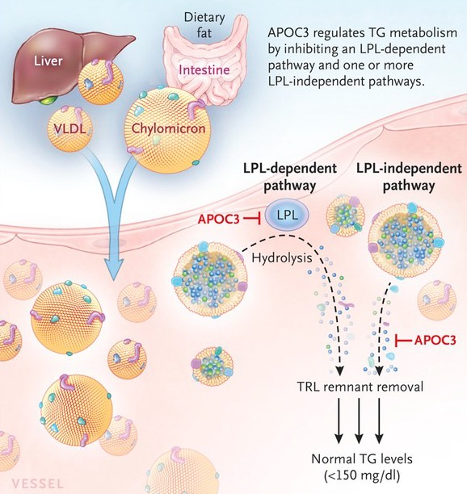
Background
Reducing triglyceride-rich lipoproteins (TRL) remains an unmet clinical need
Elevated TRLs are associated with ↑ CV risk
TRLs are at least as atherogenic as LDL
Hypertriglyceridemia has direct clinical consequences, particularly when severe
Apolipoprotein C-III
Synthesized primarily in the liver
Inhibits lipoprotein lipase
↑ triglyceride levels
Loss of function mutations in APOC3
↓ triglyceride levels
↓ CV risk
Olezarsen is a GalNAc₃-conjugated antisense oligonucleotide targeting APOC3 mRNA
An Academic Research Organization of
Brigham and Women’s Hospital and Harvard Medical School
Gaudet D. N Engl J Med. 2014;371:2200-6 Alexander VJ, et al. Eur Heart J. 2019;40:2785-96 Tardif JC, et al. Eur Heart J. 2022;43:1401-12
An Academic Research Organization of
Brigham and Women’s Hospital and Harvard Medical School

Slide 3
Objective
Assess the efficacy and safety of olezarsen in patients with moderate hypertriglyceridemia and elevated CV risk
or with severe hypertriglyceridemia
An Academic Research Organization of
Brigham and Women’s Hospital and Harvard Medical School
An Academic Research Organization of
Brigham and Women’s Hospital and Harvard Medical School

Slide 4
Trial Design
Moderate HTG (150-<500 mg/dL) + CV risk* or
Severe HTG (≥500 mg/dL)
N=154
Randomized 1:1
Cohort A 50 mg
Cohort B 80 mg
Randomized 3:1
Randomized 3:1
Olezarsen 50 mg SC Q4W
Olezarsen 80 mg SC Q4W
Placebo
Placebo
Primary Endpoint: % ∆ in triglycerides from baseline to 6 months Secondary Endpoints: % ∆ in ApoC-III, ApoB, non-HDL-C; % ∆ at 12 months Safety: ALT/AST, renal function, platelets
An Academic Research Organization of
Brigham and Women’s Hospital and Harvard Medical School
* ↑ CV risk: Established ASCVD or increased ASCVD risk (T2DM or ≥2 risk factors)

Slide 5
Trial Organization
TIMI Study Group
Marc Sabatine (Chair)
Robert Giugliano (Sr Investigator)
P. Fish & A. Jevne (Ops)
Brian Bergmark (PI)
Nicholas Marston (Investigator)
S. Murphy, E. Goodrich, S. Zhang (Stats)
Sponsor: Ionis
Sotirios Tsimikas (SVP, Global CV Dev)
Ewa Karwatowska-Prokopczuk (VP, CV Med)
Thomas Prohaska (Director, Clin Dev)
Vickie Alexander (Executive Director, Clin Dev)
Independent Data Monitoring Committee
Richard Becker (Chair) Jamie Dwyer
Willis Maddrey
Charles Davis (Statistician) François Mach
Bridge-TIMI 73a was supported by a grant from Ionis Pharmaceuticals to Brigham and Women’s Hospital.
An Academic Research Organization of
Brigham and Women’s Hospital and Harvard Medical School
An Academic Research Organization of
Brigham and Women’s Hospital and Harvard Medical School

Slide 6
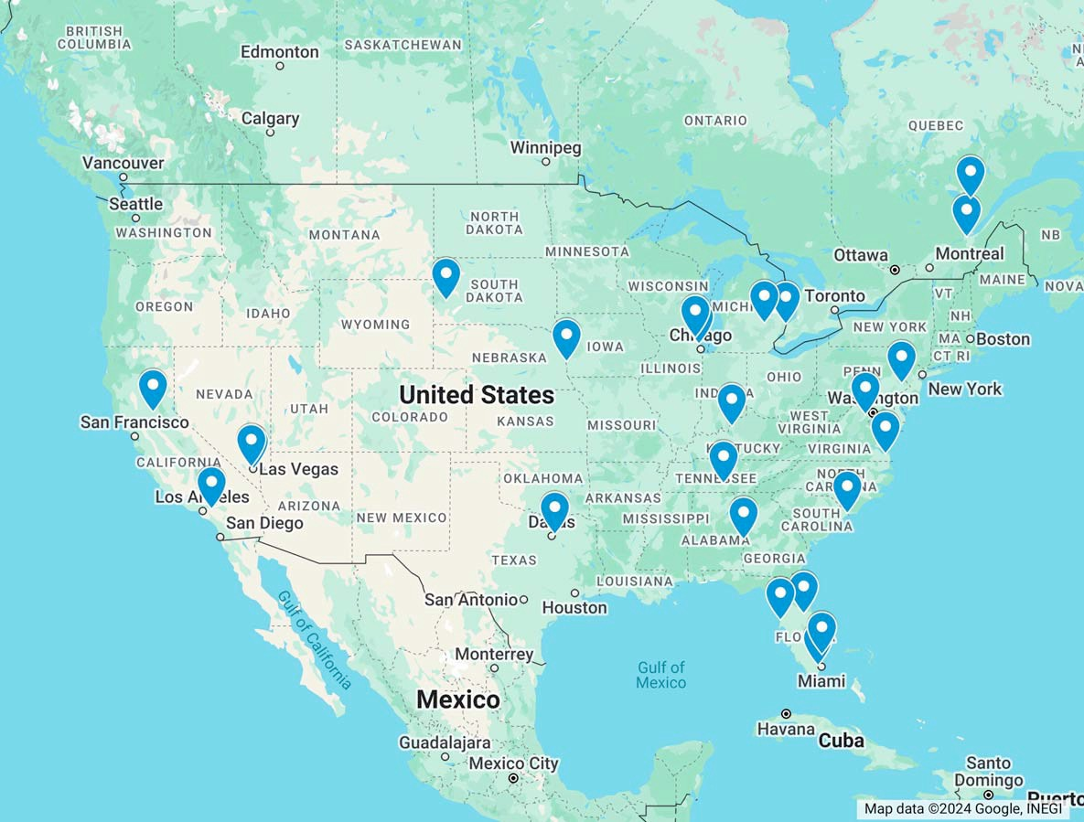
Enrollment
June – September 2022 | 24 Sites | 154 Patients
Gaudet-Canada NLI
Bergeron
Beasley
Arif
Agaiby
O’Mahony
Wayne
Marar
Geohas
Rosenfeld Andrawis
Lovell
Bays
Nakhle
Estevez
Gupta
Mohseni
Gangi
Grubb
Leichter
Gupta Baum
Barnes
de la Cruz
An Bri
AAcandeAmcicaRdeesemaircchROergsaenaizarctihonOofrganization of
g_{Brigha}ham and _{m}Wo_{a}m_{nd}en’s_{Wome}Hospital_{n’s}and _{Hos}Harva_{pita}rd M_{l}ed_{a}i_{nd}cal S_{Ha}cho_{rv}ol _{ard Medi}
cal School

Slide 7
Follow-up
Subjects randomized
N=154
Placebo Q4W |  | Olezarsen 50mg Q4W |  | Olezarsen 80mg Q4W
(N=39) |  | (N=58) |  | (N=57)
Received >1 dose (N=39; 100%) |  | Received >1 dose (N=58; 100%) |  | Received >1 dose (N=57; 100%)
Premature permanent Premature permanent Premature permanent
drug discontinuation drug discontinuation drug discontinuation
(N=3, 8%) (N=14, 24%) (N=7, 12%)
Died Died Died
(N=0, 0%) (N=1, 2%) (N=0, 0%)
Withdrew consent Withdrew consent Withdrew consent
(N=0, 0%) (N=1, 2%) (N=0, 0%)
Lost to follow-up Lost to follow-up Lost to follow-up
(N=0, 0%) (N=1, 2%) (N=1, 2%)
Completed the study Completed the study Completed the study (12 months) (12 months) (12 months)
(N=39, 100%) (N=55, 95%) (N=56, 98%)
Premature permanent drug discontinuation
N=24 (16%)
Died
N=1 (<1%)
Withdrawal of consent
N=1 (<1%)
Lost to follow-up
N=2 (1%)
Completed the study (12 months)
N=150 (97%)
An Academic Research Organization of
Brigham and Women’s Hospital and Harvard Medical School

Slide 8
Baseline Characteristics
Clinical characteristics | Total N=154
Age (yrs) | 62 (55-70)
Female sex | 42%
Race/Ethnicity
White | 92%
Hispanic/Latino | 38%
Black | 8%
Hispanic/Latino | 33%
Asian | 1%
BMI (kg/m²) | 33 (29-37)
Prior pancreatitis | 1%
Diabetes mellitus | 68%
Triglycerides and therapy ^{Total} N=154
Triglycerides (mg/dL) 242 (192-324)
Triglycerides ≥500 mg/dL 10% Any lipid-lowering therapy 97% Statin 82%
Ezetimibe 6%
Fibrate 16%
Omega-3 fatty acid 16%
Niacin 1%
PCSK9i 3%
≥2 therapies 31%
An Academic Research Organization of
Brigham and Women’s Hospital and Harvard Medical School
Values shown are % or median (IQR)

Slide 9
Olezarsen Efficacy
300
Placebo (N=39)
250
Triglycerides (mg/dL)
200
150
100
50
Values shown are median and 95% CI by treatment arm
Baseline
Day 28
Day 56
Day 84
Day 112
Day 140
Month 6
Day 196
Day 252
Day 308
Month 12
An Academic Research Organization of Brigham and Women’s Hospital and Harvard
Medical School

Slide 10
Olezarsen Efficacy
300
Placebo (N=39)
250
Triglycerides (mg/dL)
200
-49.3%
(95%CI -59.0, -39.5)
-53.1%
150
Olezarsen 50mg (N=58)
Month 6 PBO-adj % change
(95%CI -62.9, -43.4)
100
Olezarsen 80mg (N=57)
50
Values shown are median and 95% CI by treatment arm
Baseline
Day 28
Day 56
Day 84
Day 112
Day 140
Month 6
Day 196
Day 252
Day 308
Month 12
An Academic Research Organization of Brigham and Women’s Hospital and Harvard
Medical School

Slide 11
Lipid changes at 6 months
Triglycerides ApoC-III
40
20
VLDL-C Remnant
Chol.
P<0.0001 P<0.0001
for each for each
^{-46.2} -49.7 ^{-46.6} -50.1
ApoB Non-HDL-C
P<0.0001 P<0.0001
for each for each
-18.2 -18.5
_{-25.4} -23.1
HDL-C ApoA1
39.6 39.6
14.5 _{12.1}
P<0.0001 P<0.0001
for each for each
LDL-C Total
Chol.
P=0.36 P=0.24
_{-9.9} -7.7
-9.8 -9.5
% Change compared with placebo
P<0.0001
for each
P<0.0001
for each
0
-20
-40
-49.3
-53.1
-60
-64.2
-80
-73.2
Olezarsen 50 mg (N=58)
Olezarsen 80 mg (N=57)
-100 An Academic Research Organization of
Brigham and Women’s Hospital and Harvard Medical School
Values shown are placebo-adjusted LSM % changes and 95% CI at 6 months

Slide 12
Achieved TG<150 mg/dL at 6 months
In patients with moderate hypertriglyceridemia at baseline
P<0.001
93.3%
100%
P<0.001
90%
85.7%
80%
70%
60%
50%
40%
30%
20%
Percent of patients
11.8%
10%
0%
Placebo
(N=34)
Olezarsen 50 mg
(N=49)
Olezarsen 80 mg
(N=45)
An Academic Research Organization of
Brigham and Women’s Hospital and Harvard Medical School
P values are compared with placebo

Slide 13
Key Safety Parameters
Placebo N=39 |  | Olezarsen 50 mg N=58 | P-value vs Placebo | Olezarsen 80 mg N=57 | P-value vs Placebo
Treatment-emergent adverse events Any Leading to drug discontinuation Serious Leading to drug discontinuation Pancreatitis Hepatic abnormalities ALT ≥ ULN AST ≥ ULN ALT or AST ≥3x ULN Total bilirubin ≥2x ULN Alkaline phosphatase ≥2x ULN | 29 (74.4) | 42 (72.4) | 0.83 | 38 (66.7) | 0.42
 | 0 (0) | 7 (12.1) | 0.04 | 3 (5.3) | 0.27
 | 2 (5.1) | 4 (6.9) | >0.99 | 7 (12.3) | 0.30
 | 0 (0) | 1 (1.7) | >0.99 | 1 (1.8) | >0.99
 | 0 | 0 | -- | 0 | --
 | 1 (2.6) | 27 (46.6) | <0.001 | 21 (36.8) | <0.001
 | 4 (10.3) | 18 (31.0) | 0.03 | 21 (36.8) | 0.004
 | 0 | 4 (6.9) | 0.15 | 1 (1.8) | >0.99
 | 0 | 0 | -- | 0 | --
 | 0 | 0 | -- | 0 | --
An Academic Research Organization of
Brigham and Women’s Hospital and Harvard Medical School
An Academic Research Organization of
Brigham and Women’s Hospital and Harvard Medical School
Treatment phase safety data shown

Slide 14
Key Safety Parameters
Placebo N=39 |  | Olezarsen 50 mg N=58 | P-value vs Placebo | Olezarsen 80 mg N=57 | P-value vs Placebo
Renal abnormalities
eGFR decline ≥30% | 8 (20.5) | 6 (10.3) | 0.16 | 4 (7.0) | 0.06
eGFR decline ≥50% | 0 | 0 | -- | 0 | --
UPCR ≥1000 mg/g | 4 (10.3) | 4 (6.9) | 0.71 | 3 (5.3) | 0.44
Platelet count
<140K/uL | 1 (2.6) | 10 (17.2) | 0.05 | 10 (17.5) | 0.03
<100K/uL | 1 (2.6) | 0 | 0.40 | 3 (5.3) | 0.64
<75K/uL | 0 | 0 | -- | 0 | --
An Academic Research Organization of
Brigham and Women’s Hospital and Harvard Medical School
An Academic Research Organization of
Brigham and Women’s Hospital and Harvard Medical School
Treatment phase safety data shown

Slide 15
Additional Safety
12.0
Placebo
11.0
Olezarsen 50mg
10.0
Olezarsen 80mg
9.0
8.0
7.0
6.0
5.0
4.0
3.0
HbA1c (%)
2.0
PBO-adjusted LSM % change P>0.05 for both doses at Month 6 and Month 12
Baseline Month 6
An Academic Research Organization of
Brigham and Women’s Hospital and Harvard Medical School
Month 12
An Academic Research Organization of
Brigham and Women’s Hospital and Harvard Medical School

Slide 16
Olezarsen Program
Mod HTG + CV risk or Severe HTG | Bridge-TIMI 73a | Essence-TIMI 73b 1478 patients Coronary CTA substudy
Severe HTG | CORE-TIMI 72a 540 patients Hepatic MRI substudy | CORE2-TIMI 72b 390 patients Hepatic MRI substudy
 | Open Label Extension
An Academic Research Organization of
Brigham and Women’s Hospital and Harvard Medical School
An Academic Research Organization of
Brigham and Women’s Hospital and Harvard Medical School

Slide 17
Limitations
The number of patients with severe hypertriglyceridemia was small, limiting the ability to assess olezarsen’s lipid and clinical effects in these patients
Trials of olezarsen in patients with severe hypertriglyceridemia are ongoing
Treatment beyond one year was not evaluated
Open label extension programs with olezarsen are underway
These findings cannot necessarily be applied to patients with specific genetic syndromes or secondary causes of hypertriglyceridemia
Olezarsen’s effects in patients with familial chylomicronemia syndrome (Balance trial) will be presented at 9:45 am today in room B313A
An Academic Research Organization of
Brigham and Women’s Hospital and Harvard Medical School
An Academic Research Organization of
Brigham and Women’s Hospital and Harvard Medical School

Slide 18
Summary and Conclusions
In patients with largely moderate hypertriglyceridemia and elevated cardiovascular risk, olezarsen 50 mg or 80 mg monthly significantly reduced triglyceride levels
TG effect was greater than is possible with currently available treatments
There were no major safety concerns in this phase 2b trial
Olezarsen led to meaningful reductions in apolipoprotein B and non-high- density lipoprotein cholesterol, markers of atherogenic risk
An Academic Research Organization of
Brigham and Women’s Hospital and Harvard Medical School
An Academic Research Organization of
Brigham and Women’s Hospital and Harvard Medical School

Slide 19
Thank you
An Academic Research Organization of
Brigham and Women’s Hospital and Harvard Medical School
An Academic Research Organization of
Brigham and Women’s Hospital and Harvard Medical School

