Slide 1
Pulmonary Artery Catheterization and the Management of Cardiogenic Shock
Salvatore F Mannino, DO, MA, FACC, FSCAI
Director, Mechanical Circulatory Support and Cardiogenic Shock Program
WellStar Health System
Marietta, GA

Slide 2
Disclosures
Abiomed: Consultant/Speaker’s Bureau
Boston Scientific: Speaker’s Bureau
Osprey: Speakers Bureau

Slide 3
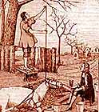
The PA Catheter: History¹
3
1711 – Hales conducts the first cardiac catheterization of a horse using brass pipes, a glass tube and the trachea of a goose
1844 – French physiologist Bernard coins the term “cardiac catheterization” and uses catheters to record intra-cardiac pressures in animals
History of Angioplasty Timeline. Angioplasty.org. http://www.ptca.org/nv/timeline.html. Accessed September 12, 2016.
NPS-128-16
Notes:
The first cardiac catheterization was performed on a horse in 1711 using brass pipes, a glass tube and the trachea of a goose. Yes, poor horse and poor goose!

Slide 4
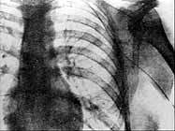

The PA Catheter: History¹⁻³
4
1929 – First documented human cardiac catheterization is performed in Germany by Warner Forssmann, MD
Chatterjee K. Circulation 2009;119(1):147-152.
Berry D. Circulation. 2006;113(7):f27-f28.
History of Angioplasty Timeline. Angioplasty.org. http://www.ptca.org/nv/timeline.html. Accessed September 12, 2016.
NPS-128-16
Notes:
The first catheterization in a HUMAN was performed by Dr. Warner Forssmann in 1929.
Most Interventional Cardiologists know this story but for those of you who don’t…
Dr. Forssmann was a surgical resident in Germany. He placed a catheter into antecubital vein, walked to basement x-ray room 1 floor below, advanced the catheter the full 60cm into his RV and then took this picture.
At the time, thought was that any entry into the heart would be fatal– immediately fired- continued to self experiment—only stopped after he had used all his veins with 17 cutdowns and went onto dogs. Because he never received any recognition for his work, he switched to urology and became a country doc.

Slide 5
The PA Catheter: History^{1,2}
5
1941 – Drs. Cournand
and Richards develop catheters that could be advanced into PA and used as a diagnostic tool for the first time, utilizing catheter techniques to measure cardiac output
1956 – Drs. Forrsmann, Cournand and Richards receive a Nobel Prize in Medicine
Chatterjee K. Circulation 2009;119(1):147-152.
Cournand AF Nobel Lectures, Physiology and Medicine 1942-1962. Amsterdam, The Netherlands: Elsevier Publishing Co; 1964:529
NPS-128-16
Notes:
But, in 1956, Dr. Forrsmann was awarded the nobel prize with Drs. Cournand and Richards who developed a catheter which could be advanced into the PA and measure cardiac output.

Slide 6
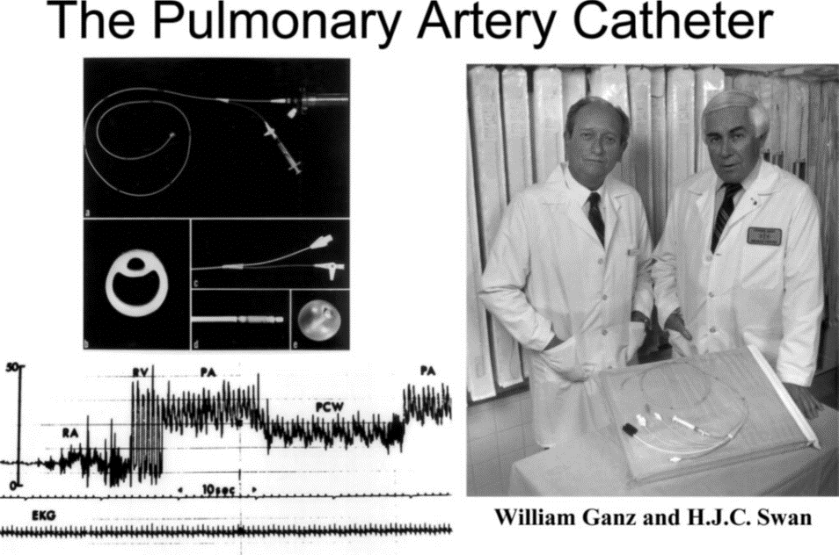
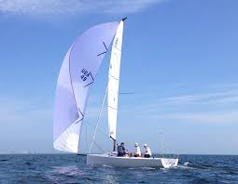
The PA Catheter: History¹⁻³
1970 – Drs. Swan and Ganz introduce first balloon flotation flow directed catheters that could be used bedside via intra-cardiac pressure tracings without fluoroscopy
Swan et al. N Engl J Med. 1970; 283:447
Chatterjee K. Circulation 2009;119(1):147-152.
Evans DC, et al. Scand J Surg. 2009;98(4):199-208.
Notes:
Swan developed the balloon tipped catheter that could be floated into the PA. Ganz added a thermistor to the tip enabling measurement of CO
Revolutionized RHC– obtain all hemodynamic parameters bedside
Prior to this, PACs were rigid and their insertions were associated with bleeding and arrhythmias. Now with a “floating” balloon tipped catheter that was flexible PACs became popular and there was an increase in ICU use.

Slide 7
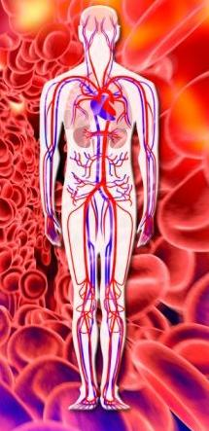
Why do we care?
Adequate circulation, or flow of blood, is essential for adequate tissue perfusion and oxygenation
Maintaining adequate tissue perfusion/oxygenation is the primary goal of therapy in any shock state
Rapid assessment and interpretation of hemodynamics are
central to this goal

Slide 8
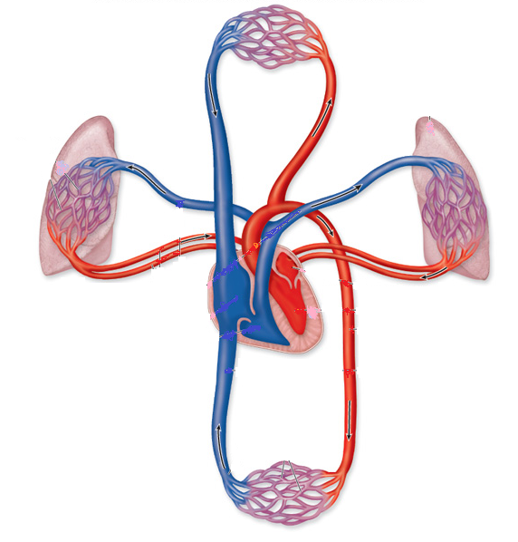
What are we monitoring?
RIGHT HEART
1. RAP +/or CVP (0-8 mmHg)¹
2. RV Systolic/Diastolic (15-30/0-8 mmHg)¹
3. PA Systolic/Diastolic (15-30/8-12 mmHg)¹
3. SVO₂ (70-75%)^{3,4}
CALCULATED DATA
Right heart pumps against PVR
(120-250 dynes*sec/cm⁻⁵)
= 80*(mean PA-PCWP)/CO³
LEFT HEART
4. PCWP = 5. Left atrial Pressure (8-12 mmHg)¹
6. LVEDP (5-12 mmHg)²
7. CO (4-7 L/min) via thermodilution (TD) or CCO PA Catheter³
8. Blood Pressure (100-140/60-90 mmHg)³
CALCULATED DATA
MAP (70-100 mmHg)=2/3*Diastolic Pressure + 1/3*Systolic Pressure³
CO (4-7L/min)= FICK eqn = (BSA ×120)/
0.1 × 1.36 × (SaO₂-SvO₂) × Hgb³
CI (2.5-4.5L/min/m²) = CO/BSA³
L Heart pumps against the SVR (SVR 800-1200dynes*sec/cm-5) = 80* (MAP-CVP)/CO³
CPO (>1.0 Watts) = CO*MAP*0.0022^{5,6}
4
7
3
5
1
8
6
2
Marso SP, Griffin BP, Topol EJ. Manual of Cardiovascular Medicine. Philadelphia: Lippincott Williams & Wilkins, 2000.
Kern MJ. The Cardiac Catheterization Handbook, 4th ed. St. Louis: Mosby Inc; 2003.
Carey CF, Lee, HH, Woeltje KF. The Washington Manual of Medical Therapeutics, 29th ed. Philadelphia: Lippincott-Raven Publishers, 1998.
Marino PL. The ICU Book, 2nd ed. Baltimore: Williams & Wilkins, 1998.
Naidu S, et al. Circulation. 2011;123(5):533-543.
Fincke J, et al. J Am Coll Cardiol. 2004;44:340-348.

Slide 10
Potential Reasons Why PAC Not Proven Beneficial
Diagnostic tool
Frequent crossover
Ethical bias
Deficiency in in data interpretation
Impractical hemodynamic endpoints
Inclusion of heterogeneous conditions

Slide 11
Clinical Assessment in Reality
Accuracy of physician predictions highest in patients without objective evidence of
heart disease
Accuracy significantly lower in patients with AMI or ischemia (*P<.05)
Significant change in therapy in 47% of all patients after results of PAC available to clinicians
Presence of comorbid illness associated with reduced accuracy of physician assessment of PCWP in patients with AMI (P<.025)
Connors AF, et al. Chest. 1990;98(5):1200-1206.
Notes:
Connors et al. purpose:
compare accuracy of physician judgements of hemodynamic status in critically ill patients with and without cardiac disease.
502 patients who were deemed to clinically require RHC: patients grouped into 1. Acute MI (stemi or nstemi), 2. acute myocardial ischemia (USA/EKG changes) 3. other objective evidence of acute heart disease or prior MI 4. no objective evidence of acute heart disease
Housestaff, fellows and attendings.
Conclusion: MD predictions of hemodynamic status often inaccurate in critically ill patients regardless of whether or not they have heart disease but much worse when heart disease is present.
Unfortunately, most would agree that the clinical exam is a dying art particular in era of ongoing advances in technology and it’s pretty clear that we require an objective assessment of hemodynamics in ICU patients.

Slide 12
Lack of Standardization in PAC Proficiency
Study | Responding Audience | Type of Test | Mean Score (% correct) | % Unable to correctly ID PCWP from clear tracing
Iberti et al 1990 “The PAC Multicenter Study”¹ | 296 physicians in 13 US & Canadian hospitals (all had ICUs and residency programs) | 31-question multiple choice exam | 67% (range, 19%-100%) | 47%
Gnaegi et al 1997² | 86 ICUs (535 critical care MDs) in France, Switzerland & Belgium | Same as Iberti et al 1990 study | 72% mean score +/-14.4% | 54%
Iberti et al 1994³ | 216 nurses registered for American Association of Critical Care Nurses’ National Teaching Institute Conference | 37-question multiple choice exam (modified version of Iberti exam) | 48.5% (mean score 16.5 with range 1-31) | 43%
Jacka et al 2002⁴ | 214 cardiovascular anesthesiologists at 29 centers in US and Canada | Survey focused on 3 scenarios: PCWP timing, management of air emboli, and PCWP waveform interpretation | N/A | 39%
Burns et al 1996⁵ | 168 critical care nurses in California | 31-question multiple choice exam (modified version of Iberti exam) | 56.8% (range, 27.6%-86.2%) | 39%
Johnston et al 2004⁶ | 5 ICUs in Australia (139 critical care nurses) | Same 31-question multiple choice exam as Burns | 42.8% (range, 12.9%-80.6%) | Not assessed; nurses not responsible for determining PCWP
Iberti TJ, et al. JAMA. 1990;264(22):2928-2932.
Gnaegi A, et al. Crit Care Med. 1997;25(2):213-220.
Iberti TJ, et al. Crit Care Med. 1994;22(10):1674-1678.
Jacka MJ, et al. Crit Care Med. 2002;30(6):1197-1203.
Burns D, et al. Am J Crit Care. 1996;5(1):49-54.
Johnston IG, et al. Anaesth Intensive Care. 2004;32(4):564-568.

Slide 13
Results Not Applicable to Cardiogenic Shock
RCTs | Results | Cardiogenic Shock Patients?
Shoemaker 1988 | Goal oriented hemodynamic therapy demonstrated no difference in mortality (surgical patients) | No
Sandham 2003 | Goal oriented hemodynamic therapy demonstrated no difference in mortality (surgical patients) | No
NHLBI ARDS 2006 | No difference in mortality (mixed ICU) | No
Guyatt 1991 | No difference in mortality (mixed ICU) | No
Rhodes 2001 | PAC is not associated with increased mortality (mixed ICU) | Yes (42/201)
Richard 2003 | No difference in mortality (mixed ICU) | Yes (5% PAC, 7.2% in Control) but AMI with CGS was an exclusion criteria
Harvey 2005 PAC-Man Trial | No difference in mortality (mixed ICU) | No
Joyce 1990 | No difference in outcomes in low risk patients (elective AAA) | No
Bender 1997 | No difference in mortality nor morbidity (elective vascular surgery) | No
Valentine 1998 | No difference in outcomes with perioperative optimization (elective AAA) | No
Pearson 1989 | No difference in morbidity nor mortality (elective cardiac surgery) | No
The ESCAPE Trial 2005 | No difference in outcomes (chronic CHF) | No
Notes:
There are 15 total RCTs to date. Only 2 included CGS patients: Rhodes 2001 and Richard 2003; however these were primarily MICU studies; Richard 2003 AMI with CGS was an exclusion criteria

Slide 14
Variants of Cardiogenic Shock
Vasodilatory/SIRS type response occurs in 20%
  SBP< 90 mm Hg
  Cardiac Index < 2.2 L/Min/M2
  Normal to decreased SVR
Normotensive Shock
  SBP > 90 mm Hg without pressors
  Cardiac index < 2.2 L/Min/M²
  Markedly increase SVR

Slide 15
Cardiac Power Output (CPO)
Cardiac Output X Mean Arterial Pressure / 451
Most potent hemodynamic indicator in cardiogenic shock¹
<0.6 Watts bad prognostic sign
0.53 Watts PPV 58% NPV 71% for mortality¹
Contemporarily utilized as a titration parameter
(1) JACC 2004;44:340-8

Slide 16
Identification of Right Heart Systolic Dysfunction
CI <= 2.2 l/min/m2 despite left sided support
Combined with any of the following:
CVP > 15 mm Hg
CVP/PCWP > 0.63
PAPi = Pulmonary Artery Pulsatility index
= (PASP-PADP)/CVP <= 0.9

Slide 17
Cardiogenic Shock
SBP<90 (or >30 mm Hg decrease MAP from baseline), PCWP >=18 CI < =1.8 without pressors, CI <=2.2 on low dose pressors
Intra-aortic Balloon Pump
Impella CP or 5.0
ECMO with Impella for Left Ventricular Unloading
Consider Surgical LVAD/RVAD/TAH/OHT if unable to wean Impella after 4-5 days
RP Impella
Cardiogenic Shock
pH <= 7.3, Lactate > 2, CPO < 0.6 W
X
Refractory or worsening
shock after 30 minutes
Inability to oxygenate,
VIS > 40, recurrent ventricular arrhythmias, or on-going
cardiac arrest
Refractory or worsening shock after 4-6 hours
MCS Team Consultation with Patient and Family
Pulmonary Artery Pulsatility index
PAPi= (PASP-PADP)/CVP
End of Life Discussion
Refractory or worsening shock after 4-5 days
PAPi <= 0.9
CVP > 15
CVP/PCWP > 0.63 or
TAPSE <= 14
CPO <= 0.6
Vasoactive Inotrope Score (VIS)
Dopamine (mcg/kg/min)+ Dobutamine (mcg/kg/min) + (10,000 X Vasopressin (units/kg/min))
+ (10 X Milrinone (mcg/kg/min))
+ (100 X Epinepherine (mcg/kg/min))
+ (100 X Norepinepherine (mcg/kg/min)).
Refractory or worsening shock after 4-5 days

Slide 18
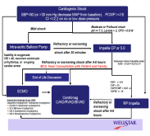
WellStar Impella Cardiogenic Shock Survival
Cardiogenic Shock Algorithm Formalized 4/20/2016
65%
N=20
74%
N=23
58%
N=19
50%
N=18

Slide 19
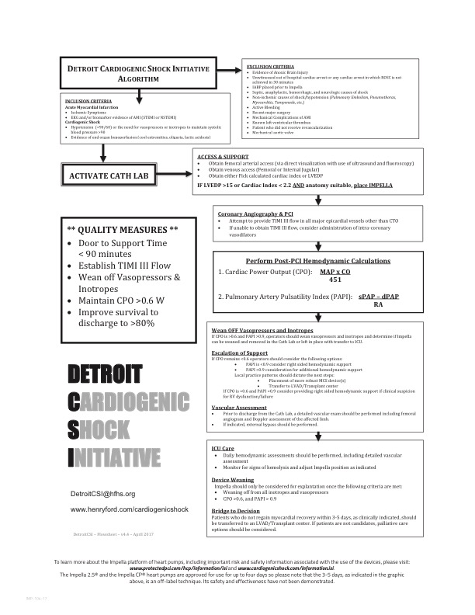
Detroit Cardiogenic Shock Initiative Protocol

Slide 20
Hemodynamic Monitoring associated with Improved Survival in AMI/CGS
P<0.0001
P=0.002
N=8767
N=5217
N=634
N=516
Abiomed Impella Quality (IQ) Database, US AMI/CGS Apr 2009– Jan 2017. Survival to Explant. Danvers, MA: Abiomed.
cVAD survival to explant 2009-2016

Slide 21
Conclusions
Cardiogenic shock patients have been under-represented in trials involving PAC.
PAC provides pivotal, adjunct hemodynamic data in cardiogenic shock that is critical to guiding therapy.
Contemporary data demonstrate PAC utilization in cardiogenic shock is associated with improved survival.

Slide 22


How Would You Manage the Most Lethal Cardiac Condition We Treat?
Adapted with permission from N. Kapur

Slide 23

Thank You

