Slide 1
Coronary Sinus Reducer for the treatment of refractory
angina: a randomised,
placebo-controlled trial (ORBITA-COSMIC)
Michael Foley MBBS, BSc
@MikeFoley89
On behalf of the ORBITA-COSMIC investigators Chief investigator: Rasha Al-Lamee MBBS, PhD

Slide 2
Disclosures
Speaker’s fees – Menarini Pharmaceuticals
Consultant fees - Philips

Slide 3
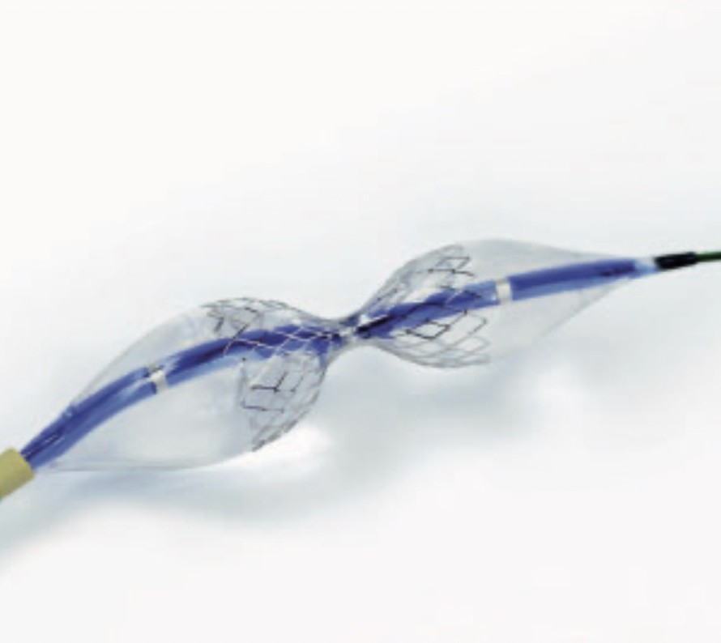
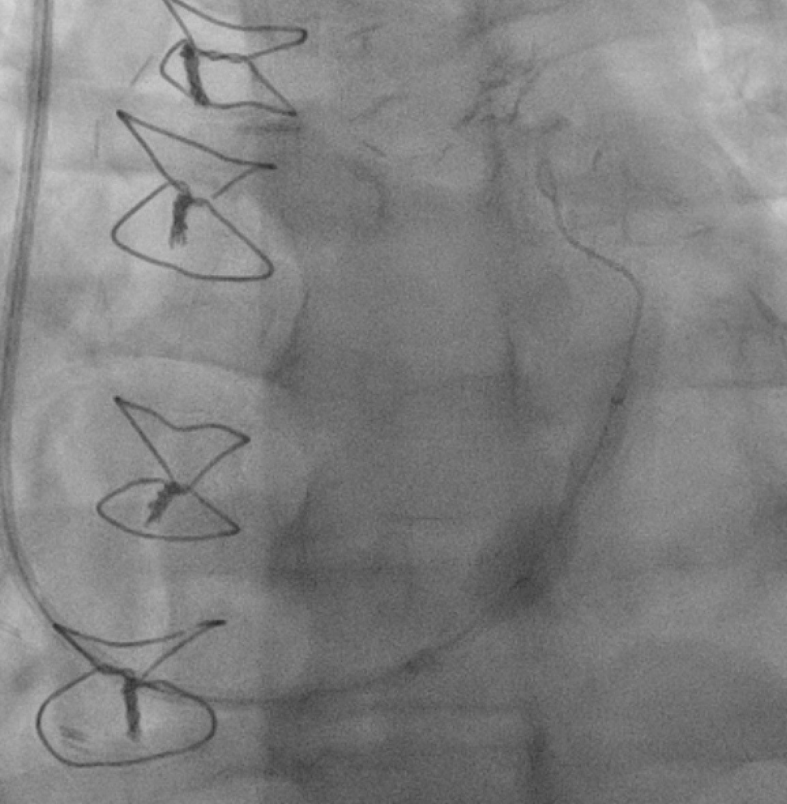
Coronary sinus reducer

Slide 4
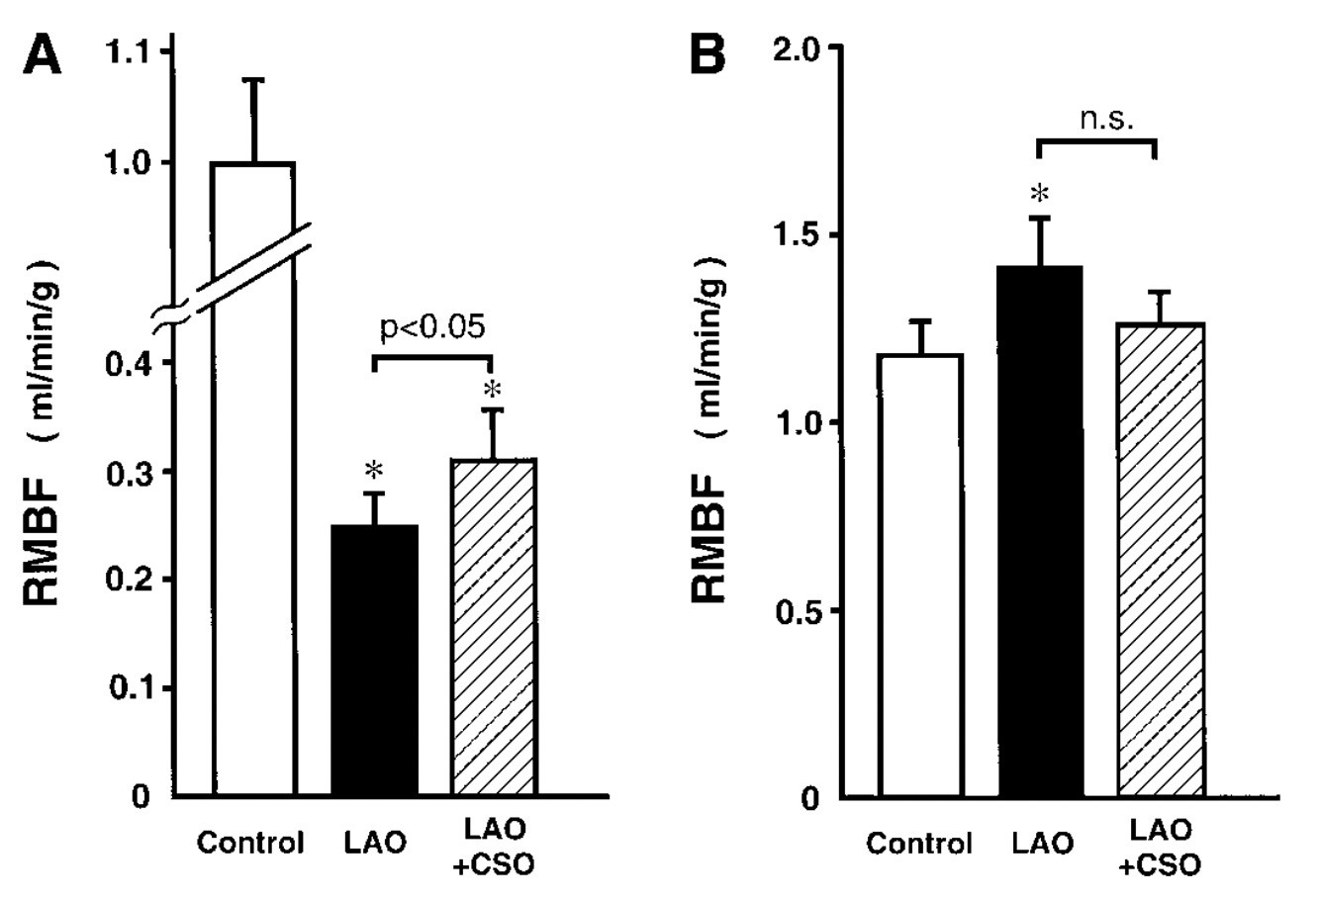
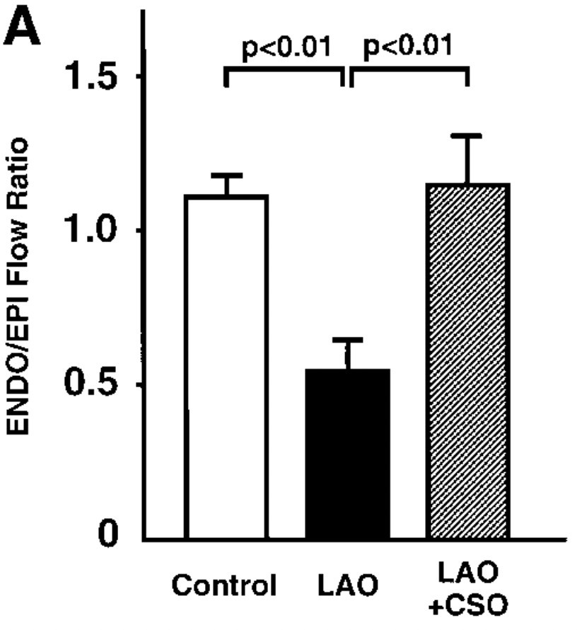
Hypothesised mechanism of action
Ischaemic myocardium Subendocardium
Ido et al. Am J Physiol Heart Circ Physiol. 2001 Mar;280(3)

Slide 5
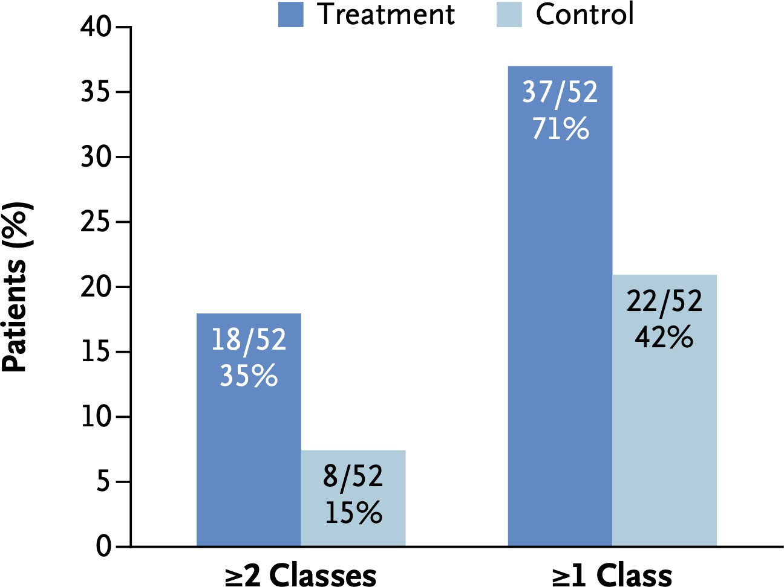
The COSIRA trial
Primary endpoint improvement in ≥2 Canadian Cardiovascular Society classes
CSR group 18/52 (35%)
Placebo group 8/52 (15%)
p=0.02
Verheye et al. N Engl J Med. 2015 Feb 5;372(6):519-27

Slide 6
What is the true placebo-controlled impact of the coronary sinus reducer on:

Slide 7
Inclusion criteria
Epicardial coronary artery disease
Myocardial ischaemia
? l egl _ ml k _vgk sk rmjcp_rcb
_l rg_l egl _j k cbga_rgml
No further options for PCI or CABG

Slide 8
Randomisation
Enrolment
Symptom Assessment
Symptom Assessment
Randomisation
Follow Up
Stress perfusion CMR
Daily angina assessment on smartphone application
Internal jugular access
Daily angina assessment on smartphone application
Stress perfusion CMR
Right atrial pressure measurement
Questionnaires
Questionnaires
Coronary sinus venogram
CCS class
Auditory isolation
CCS class
Deep conscious sedation
CSR
Exercise test
Exercise test
RANDOMISATION
PLACEBO
2 weeks
6 months

Slide 9
Stress perfusion CMR

Slide 10
Primary outcomes
Imaging:
Myocardial blood flow at stress
Symptoms:
Daily angina episodes on ORBITA-app

Slide 11
209 patients met inclusion criteria
148 patients excluded
61 patients reviewed in COSMIC-MDT
10 patients excluded
51 patients randomly assigned
25 allocated CSR
26 allocated placebo
2 embolisations: 1 remained blinded 1 not successfully implanted
22 received CSR
26 received placebo
24 available for intention to treat analysis
26 available for intention to treat analysis

Slide 12
Baseline characteristics
 | CSR, N = 25 | Placebo, N = 26
Age (years) | 72 (63 to 74) | 67 (61 to 72)
Male | 21 (84%) | 23 (88%)
Previous CABG | 21 (84%) | 23 (88%)
Previous PCI | 14 (56%) | 14 (54%)
Canadian Cardiovascular Society class
II | 2 (8%) | 1 (4%)
III | 19 (76%) | 17 (65%)
IV | 4 (16%) | 8 (31%)
Angina duration (months) | 60.0 (22.0 to 96.0) | 36.0 (18.0 to 60.0)
No. antianginal medications (median) | 4.0 (3.0 to 4.0) | 3.0 (3.0 to 4.0)
n (%); Median (IQR)

Slide 13
Enrolment CMR data
 | Baseline CMR data
Ischaemic segments | 454 / 800 (56.8%)
Segments with scar | 176 / 800 (22.0%)
Segments with full thickness scar | 0/800 (0.0%)
Stress myocardial blood flow in ischaemic segments (ml/min/g) | 1.08 (0.77 to 1.41)
Global stress myocardial blood flow (ml/min/g) | 1.33 (1.03 to 1.51)
Global myocardial perfusion reserve | 1.76 (1.52 to 2.10)
Left ventricular ejection fraction | 62.0 % (57.0 to 67.0)
n (%); Median (IQR)

Slide 14
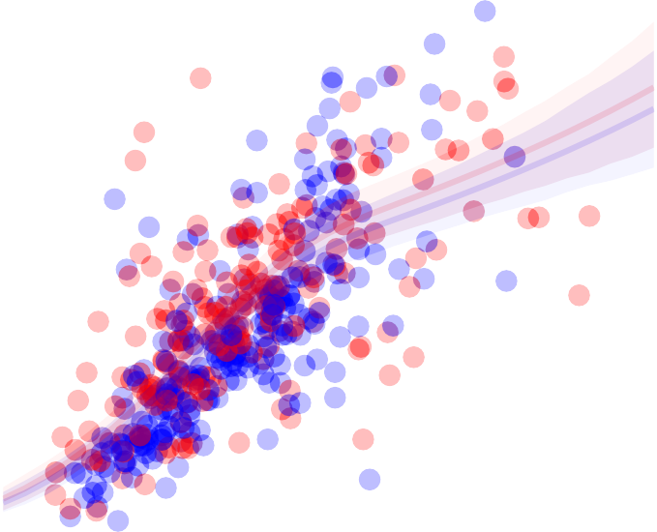
Primary imaging outcome
4
Stress MBF follow-up ml/min/g
Difference 0.06ml/min/g
(95% CrI -0.09 to 0.20)
Pr(Benefit)=78.8%
Treatment
3
CSR
Placebo
2
1
0
0
1 2 3
Stress MBF enrolment ml/min/g

Slide 15
CSRCSR
PlaceboPlacebo
Episodes of angina
CSR improved angina episodes
OR 1.40
(95% CrI 1.08 to 1.83)
Pr(Benefit)=99.4%
10
9
8
7
6
5
4
3
2
1
0

Slide 16
SAQ angina frequency
100
90
CSR
Placebo
SAQ angina frequency benefit 16.0
(95% CrI 5.1 to 27.3)
Pr(Benefit)=99.7%
80
Follow−up SAQ Frequency
70
60
50
40
30
20
10
0
0 10 20 30 40 50 60 70 80 90 100
Baseline SAQ Frequency

Slide 17
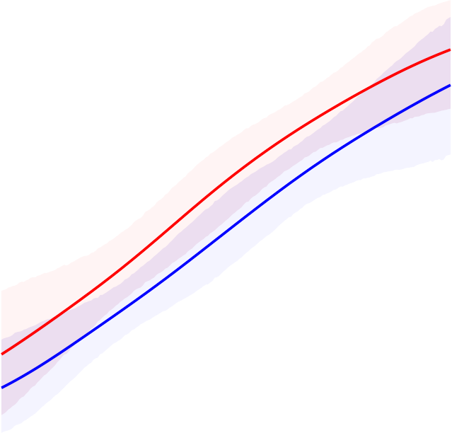
MacNew heart disease related quality of life
7
CSR
6
Placebo
MacNew placebo- controlled increment 0.60
(95% CrI 0.15 to 1.06)
Pr(Benefit)=99.4%
Follow−up MacNew score
5
4
3
2
1
0
0
1
2 3 4 5
Baseline MacNew score
6
7

Slide 18
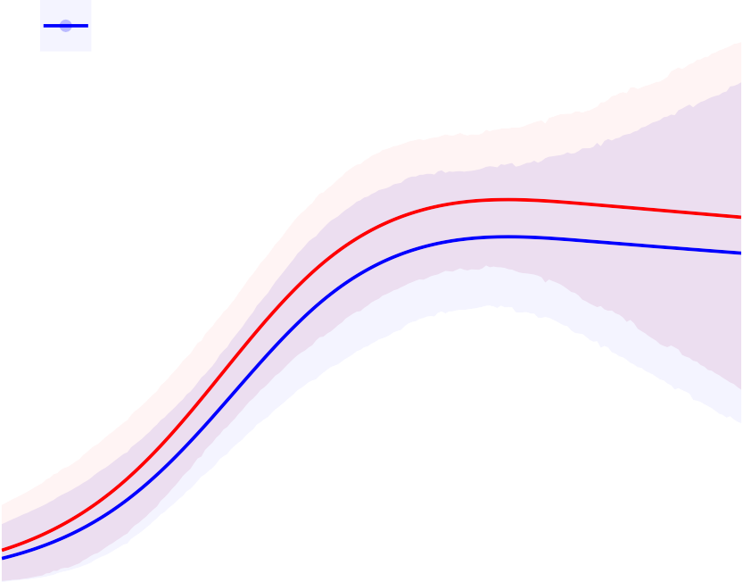
Treadmill exercise time
14
12
CSR
Placebo
Treadmill exercise time increment 40.7s
(95% CrI -36.1 to 120.2)
Pr(Benefit)=84.8%
Follow−up ETT time (min)
10
8
6
4
2
0
0
2
4 6 8 10
Baseline ETT time (min)
12
14

Slide 19
Endocardial:epicardial ratio
 | Difference at follow up for CSR vs placebo | Probability of benefit with CSR vs placebo*
Endo:epi ratio stress MBF
Ischaemic segments | 0.09 (95% CrI 0.00 to 0.17) | 98.2%
Non-ischaemic segments | -0.02 (95% CrI -0.10 to 0.07) | 35.1%
Difference | 0.10 (95% CrI 0.02 to 0.19) | 99.2%
( B gddcpcl ac gq NP&Gl rcp_argml '

Slide 20
ORBITA-COSMIC conclusions
The coronary sinus reducer resulted in:
No improvement in transmural myocardial perfusion
Improvement in subendocardial perfusion
Reduced angina frequency
Improved heart disease related quality of life

Slide 21
ORBITA-COSMIC in context
CSR causes placebo- controlled angina benefit
Improvement in myocardial blood flow to sub-endocardium
Mechanism of action is uncertain
CSR is a third treatment option for refractory angina

Slide 23
ORBITA-COSMIC investigators
Imperial College London Michael Foley, Christopher Rajkumar, Fiyyaz Ahmed-Jushuf, Florentina Simader, Sashiananthan Ganesananthan, Danqi Wang, Muhammad Mohsin, Ahmed Salih, Prithvi Dixit, Rachel Pathimagaraj, Graham Cole, Ricardo Petraco, James Howard, Jamil Mayet, Darrel Francis, Matthew Shun-Shin, Rasha Al-Lamee | Royal Free London NHS Foundation Trust Tushar Kotecha
Imperial College London Healthcare NHS Trust Ramzi Khamis, Rodney Foale, Jonathan Anderson, Ghada Mikhail, Henry Seligman, Sukhjinder Nijjer, Sayan Sen, Raffi Kaprielian, Iqbal Malik, Michael Bellamy | University Hospitals Bristol NHS Foundation Trust Tom Johnson
Mid and South Essex NHS Foundation Trust Thomas Keeble, John Davies, Gerald Clesham | The Royal Brompton Hospital, Guys and St Thomas’ NHS Foundation Trust Ranil De Silva, Jonathan Hill, Kevin Cheng
St George’s University Hospitals NHS Foundation Trust James Spratt, Claudia Cosgrove | University Hospitals of Dorset NHS Foundation Trust Peter O’Kane

Slide 24
